Slide 1
Lecture 10: Fluid dynamics
Omer Bromberg
omerbr@tauex.tau.ac.il
Winter 2023/4
Based on chapters from Advanced classical physics course by Amir Levinson

Slide 2
Part I : The fluid equations

Slide 3
Definition of a fluid:
Fluid: A liquid or gas or other material that continuously deforms under the influence of shear or stress.
This is unlike solids who resist shear forces and when applied with a constant shear they stop deforming at some fixed strain angle.
On microscale a fluid is a collection of particles that move together.
On macroscale fluids can be approximated by continuous fields.
Their dynamics can be described by a collection of continuous equations, as long as the scales are large :
Hydrodynamic scales ≫ range of intermolecular forces

Slide 4
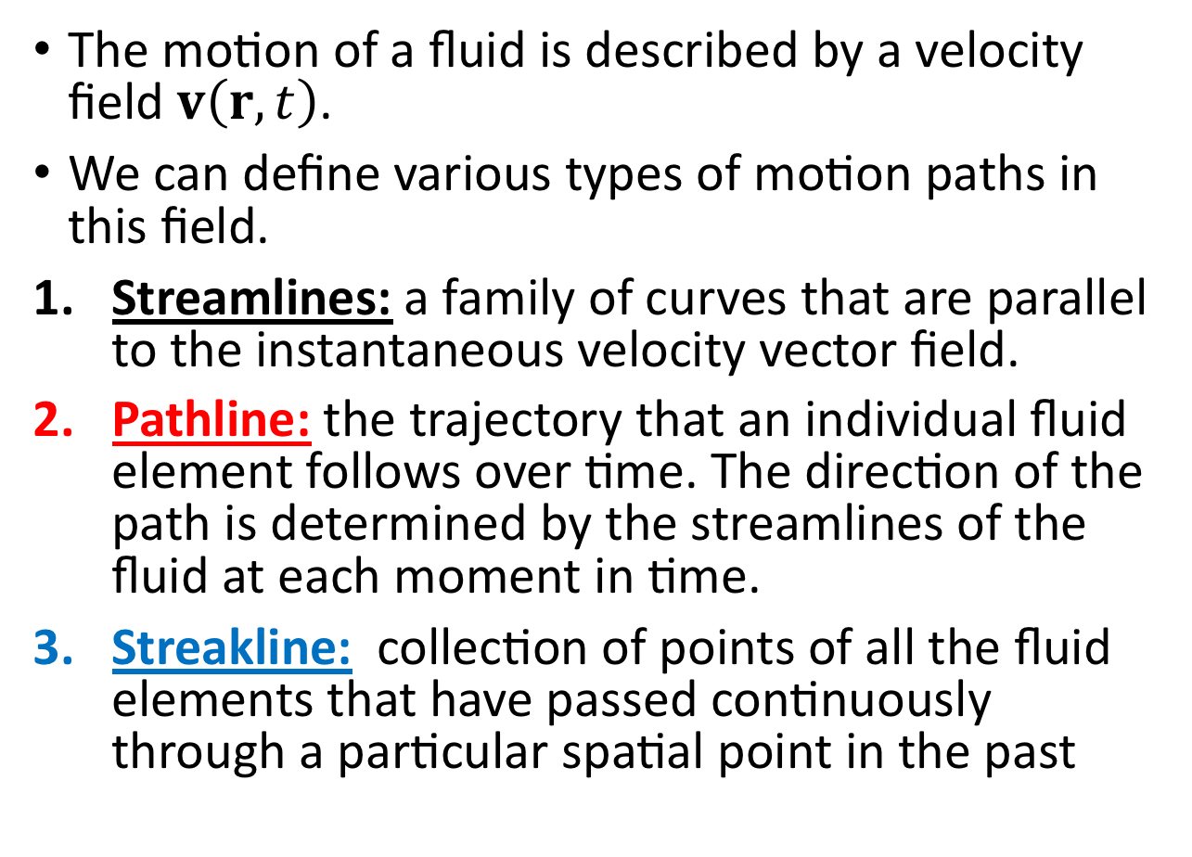
Paths of flows
The motion of a fluid is described by a velocity field $v\left(r,t\right)$.
We can define various types of motion paths in this field.
Streamlines: a family of curves that are parallel to the instantaneous velocity vector field.
Pathline: the trajectory that an individual fluid element follows over time. The direction of the path is determined by the streamlines of the fluid at each moment in time.
Streakline: collection of points of all the fluid elements that have passed continuously through a particular spatial point in the past
From Wikipedia

Slide 5
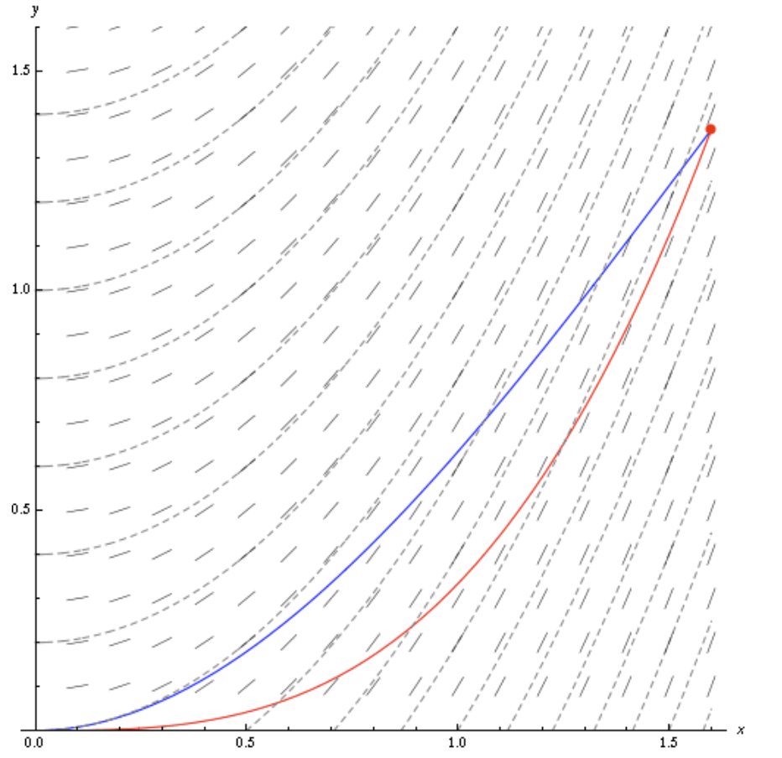
Paths of flows
The motion of a fluid is described by a velocity field $v\left(r,t\right)$.
We can define various types of motion paths in this field.
Streamlines: a family of curves that are parallel to the instantaneous velocity vector field.
Pathline: the trajectory that an individual fluid element follows over time. The direction of the path is determined by the streamlines of the fluid at each moment in time.
Streakline: collection of points of all the fluid elements that have passed continuously through a particular spatial point in the past
From Wikipedia

Slide 6
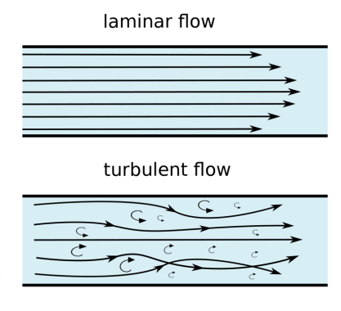
Types of flows
Steady flow: A flow in which all conditions at any point remain constant in time. In such a flow streamlines, streaklines and pathlines coincide
Unsteady flow: A time dependent flow
Laminar flow: Characterized by smooth or regular paths of particles in layers, with little or no mixing between layers. Can be steady or unsteady
Turbulent flow: Chaotic changes in fluid variables (and flow pattern). Always unsteady

Slide 7
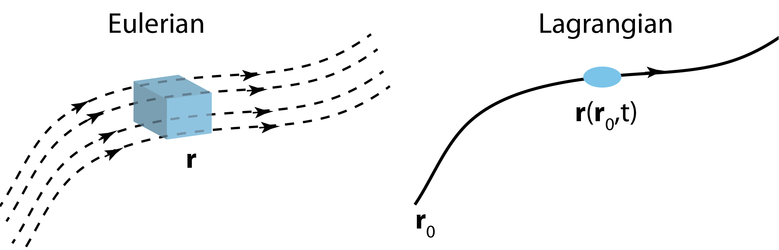
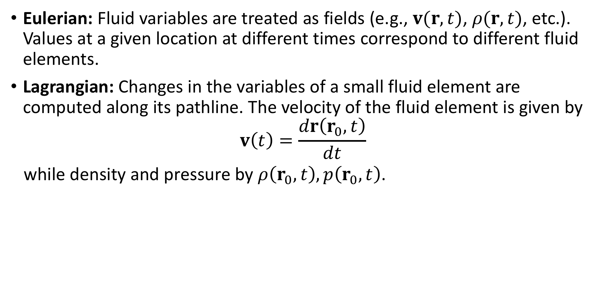
Eulerian versus Lagrangian approach
Eulerian: Fluid variables are treated as fields (e.g., $v(r, t)$, $ρ(r, t)$, etc.). Values at a given location at different times correspond to different fluid elements.
Lagrangian: Changes in the variables of a small fluid element are computed along its pathline. The velocity of the fluid element is given by
$$v\left(t\right)=\frac{dr\left(r_{0},t\right)}{dt}$$
while density and pressure by $ρ\left(r_{0}, t\right), p\left(r_{0}, t\right)$.

Slide 8
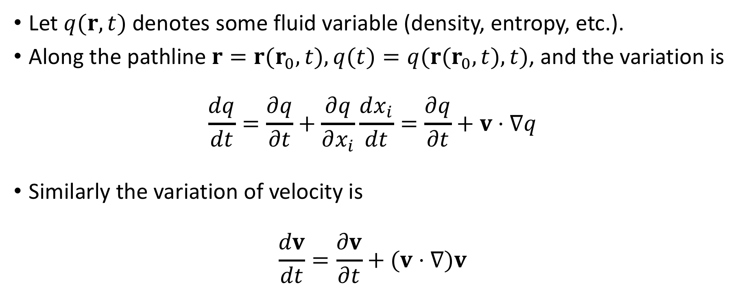
Conservative derivative
What is the relation between the two descriptions?
Let $q(r, t)$denotes some fluid variable (density, entropy, etc.).
Along the pathline $r=r(r_{0}, t), q(t)=q(r(r_{0}, t), t)$, and the variation is
$$\frac{dq}{dt}=\frac{∂q}{∂t}+\frac{∂q}{∂x_{i}}\frac{dx_{i}}{dt}=\frac{∂q}{∂t}+v⋅∇q$$
Similarly the variation of velocity is $\frac{dv}{dt}=\frac{∂v}{∂t}+(v⋅∇)v$
The operator $∂/∂t+v⋅∇$ is called the convective derivative

Slide 9
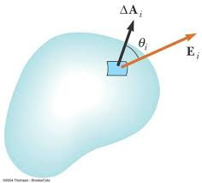


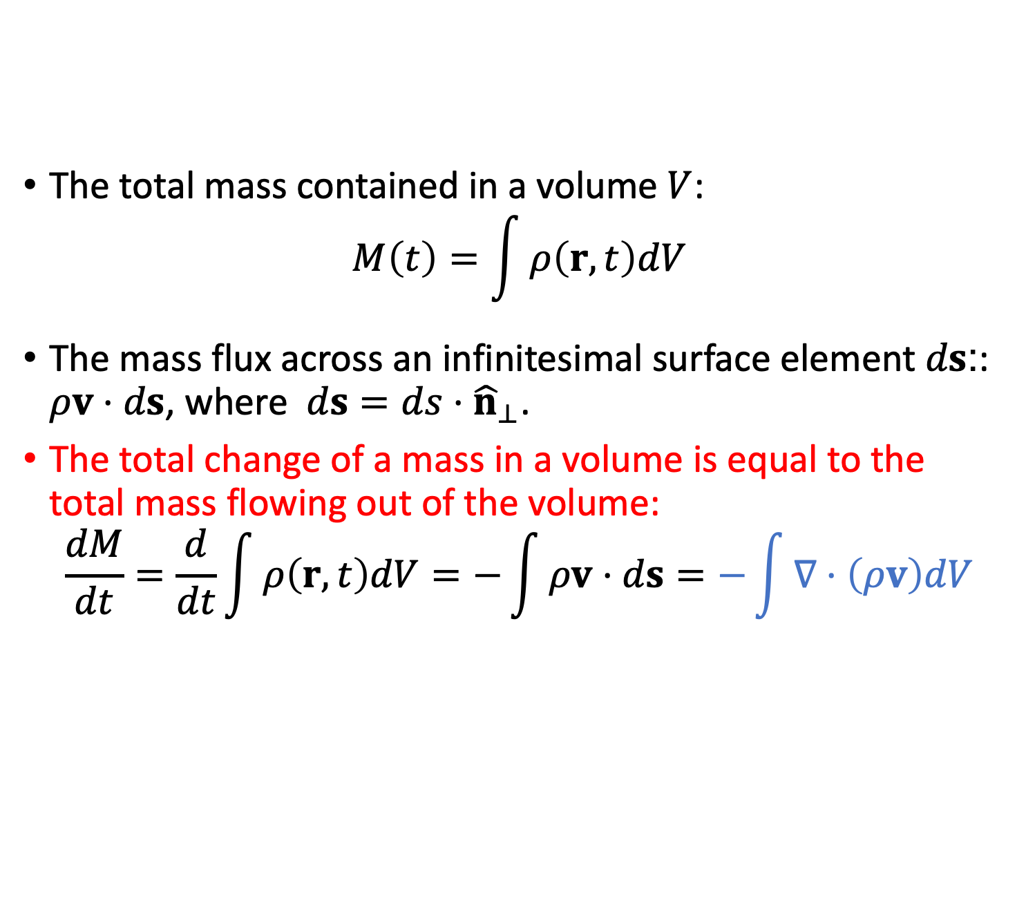




Mass conservation (Eulerian description)
The total mass contained in a volume $V$:
$$M\left(t\right)=\int{ρ\left(r,t\right)dV}$$
The mass flux across an infinitesimal surface element $ds$:: $ρv⋅ds$, where $ds=ds⋅{\hat{n}}_{⊥}$.
The total change of a mass in a volume is equal to the total mass flowing out of the volume:
$$\frac{dM}{dt}=\frac{d}{dt}\int{ρ\left(r,t\right)dV}=−\int{ρv⋅ds}=−\int{∇⋅\left(ρv\right)dV}$$
$$ds$$
$$V$$
$$ρv$$
$$V$$
$$S$$
$$V$$
Gauss’s theorem

Slide 10



Mass conservation (Eulerian description)
The total mass contained in a volume $V$:
$$M\left(t\right)=\int{ρ\left(r,t\right)dV}$$
The mass flux across an infinitesimal surface element $ds$:: $ρv⋅ds$, where $ds=ds⋅{\hat{n}}_{⊥}$.
The total change of a mass in a volume is equal to the total mass flowing out of the volume:
$$\frac{dM}{dt}=\frac{d}{dt}\int{ρ\left(r,t\right)dV}=−\int{ρv⋅ds}=−\int{∇⋅\left(ρv\right)dV}$$
Since the volume is fixed $M=M(t)$
$$\frac{dM}{dt}= \frac{d}{dt}\int{ρ\left(r,t\right)dV}=\int{\frac{∂}{∂t}ρ\left(r,t\right)dV}$$
$$ds$$
$$V$$
$$ρv$$
$$V$$
$$S$$
$$V$$
Gauss’s theorem
$$V$$
$$V$$

Slide 11
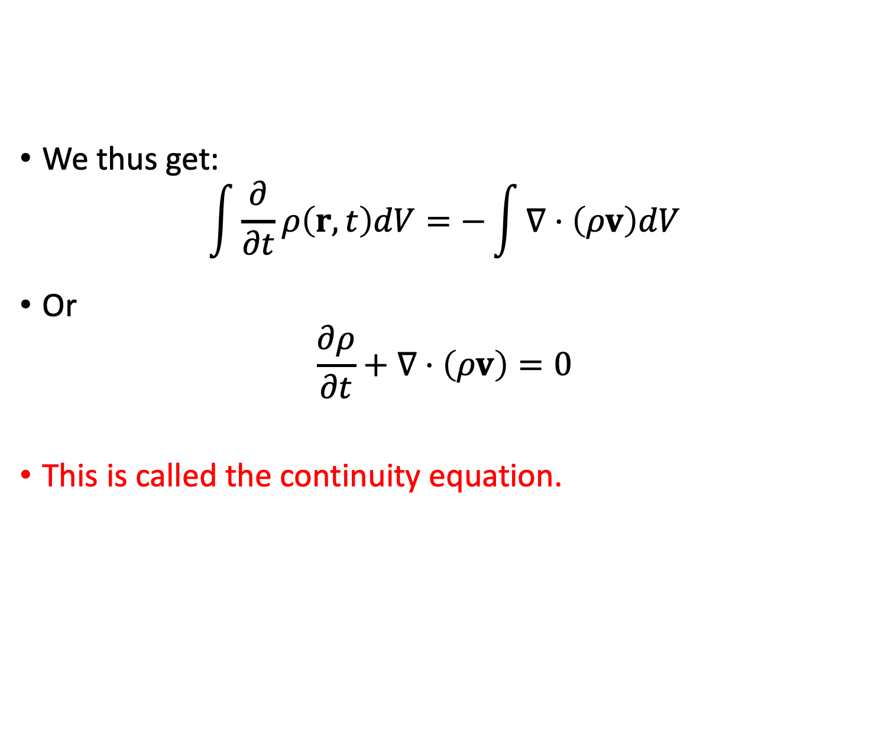

Mass conservation (Eulerian description)
We thus get:
$$\int{\frac{∂}{∂t}ρ\left(r,t\right)dV}=−\int{∇⋅\left(ρv\right)dV}$$
Or
$$\frac{∂ρ}{∂t}+∇⋅\left(ρv\right)=0$$
This is called the continuity equation.
$$ds$$
$$ρv$$
$$V$$
$$V$$

Slide 12

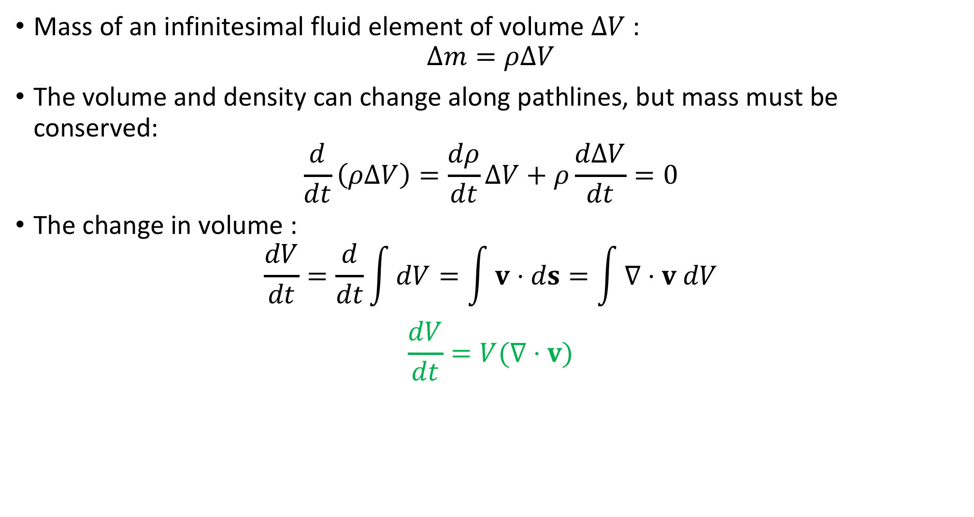

Mass conservation (Lagrangian approach)
Mass of an infinitesimal fluid element of volume $∆V$ :
$$Δm=ρΔV$$
The volume and density can change along pathlines, but mass must be conserved:
$$\frac{d}{dt}\left(ρΔV\right)=\frac{dρ}{dt}ΔV+ρ\frac{dΔV}{dt}=0$$
The change in volume :
$$\frac{dV}{dt}=\frac{d}{dt}\int{dV}=\int{v⋅ds}=\int{∇⋅v dV}$$
$$\frac{dV}{dt}=V(∇⋅v)$$
$$V$$
$$S$$
$$V$$

Slide 13
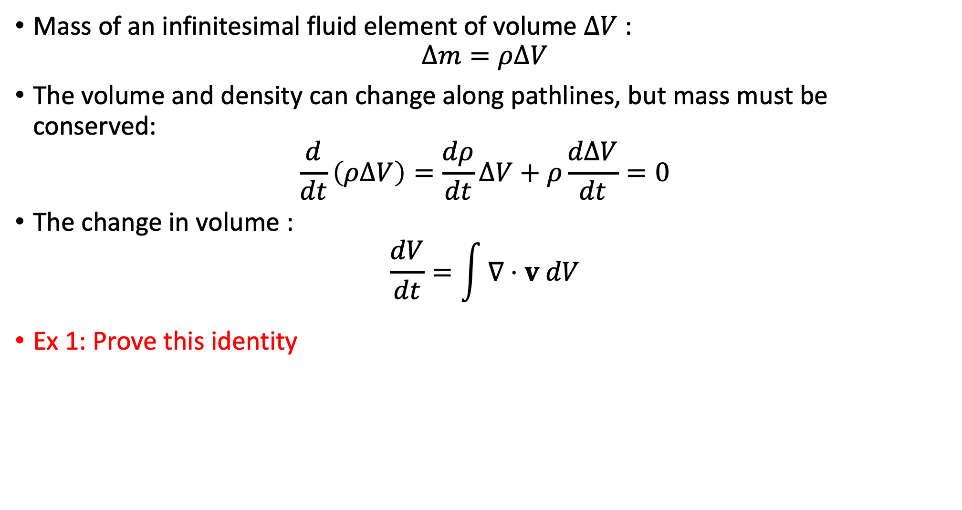
Mass conservation (Lagrangian approach)
Mass of an infinitesimal fluid element of volume $∆V$ :
$$Δm=ρΔV$$
The volume and density can change along pathlines, but mass must be conserved:
$$\frac{d}{dt}\left(ρΔV\right)=\frac{dρ}{dt}ΔV+ρ\frac{dΔV}{dt}=0$$
The change in volume :
$$\frac{dV}{dt}=\int{∇⋅v dV}$$
Ex 1: Prove this identity
$$V$$

Slide 14

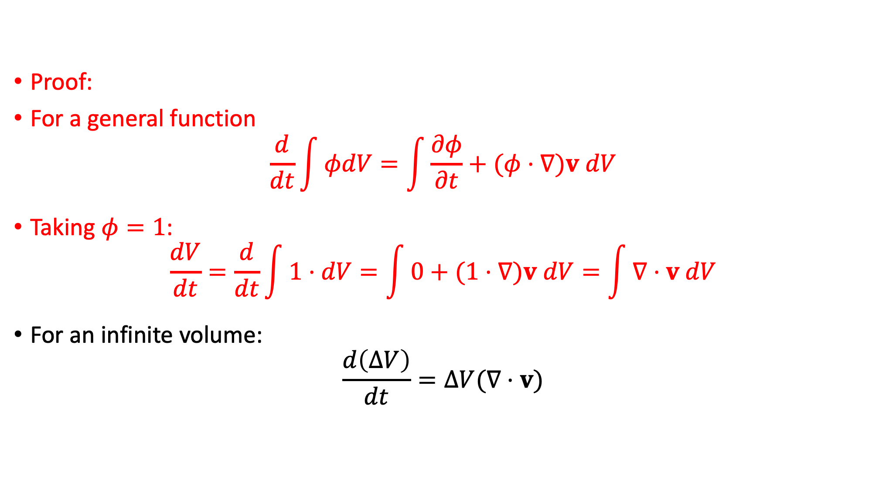



Mass conservation (Lagrangian approach)
Proof:
For a general function
$$\frac{d}{dt}\int{φdV}=\int{\frac{∂φ}{∂t}+(φ⋅∇)v dV}$$
Taking $φ=1$:
$$\frac{dV}{dt}=\frac{d}{dt}\int{1⋅dV}=\int{0+(1⋅∇)v dV}=\int{∇⋅v dV}$$
For an infinite volume:
$$\frac{d\left(ΔV\right)}{dt}=ΔV(∇⋅v)$$
$$V$$
$$V$$
$$V$$
$$V$$
$$V$$

Slide 15
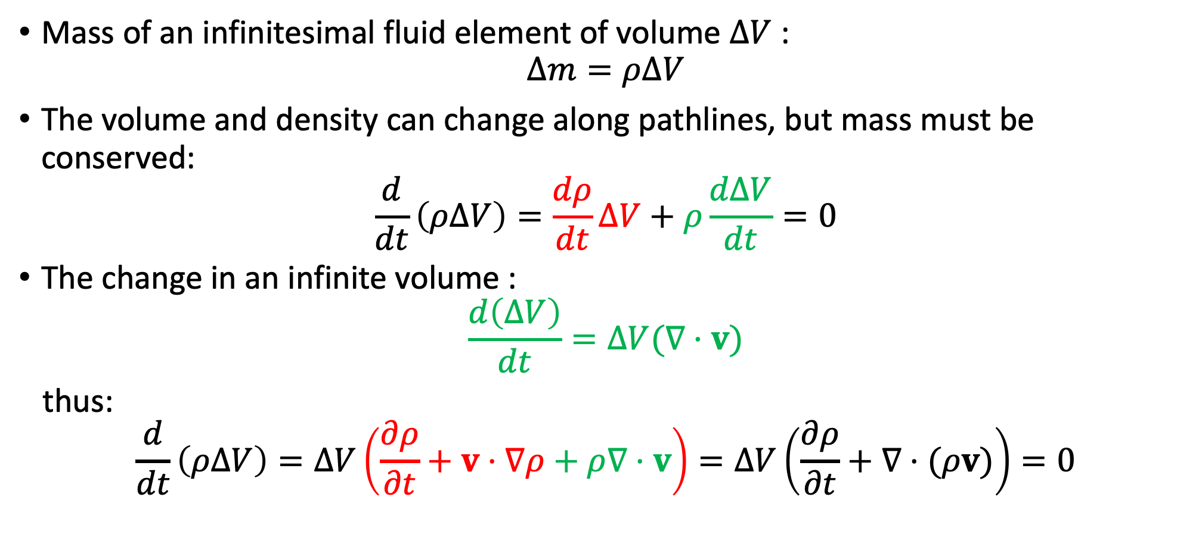
Mass conservation (Lagrangian approach)
Mass of an infinitesimal fluid element of volume $∆V$ :
$$Δm=ρΔV$$
The volume and density can change along pathlines, but mass must be conserved:
$$\frac{d}{dt}\left(ρΔV\right)=\frac{dρ}{dt}ΔV+ρ\frac{dΔV}{dt}=0$$
The change in an infinite volume :
$$\frac{d\left(ΔV\right)}{dt}=∆V(∇·v)$$
thus:
$$\frac{d}{dt}\left(ρΔV\right)=ΔV\left(\frac{∂ρ}{∂t}+v⋅∇ρ+ρ∇⋅v\right)=ΔV\left(\frac{∂ρ}{∂t}+∇⋅(ρv)\right)=0$$

Slide 16
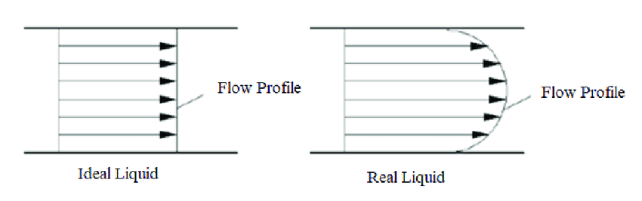
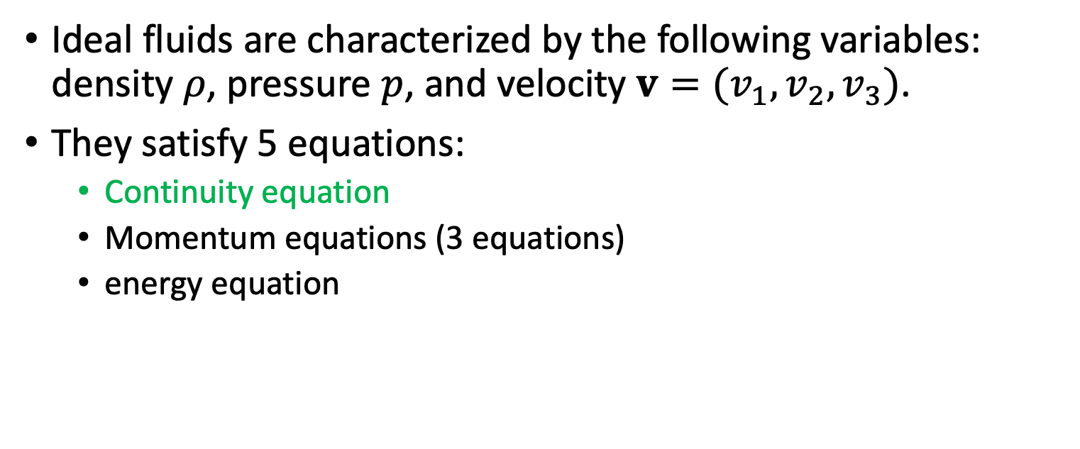
Dynamics of an ideal fluid
Ideal fluid: A fluid that has no shear stresses, viscosity or energy exchange (heat conduction or radiative cooing) with its surroundings
Ideal fluids are characterized by the following variables: density $ρ$, pressure $p$, and velocity $v=(v_{1}, v_{2}, v_{3})$.
They satisfy 5 equations:
Continuity equation
Momentum equations (3 equations)
energy equation
flow
profile
✓
Ideal fluid
flow
profile
real fluid

Slide 17
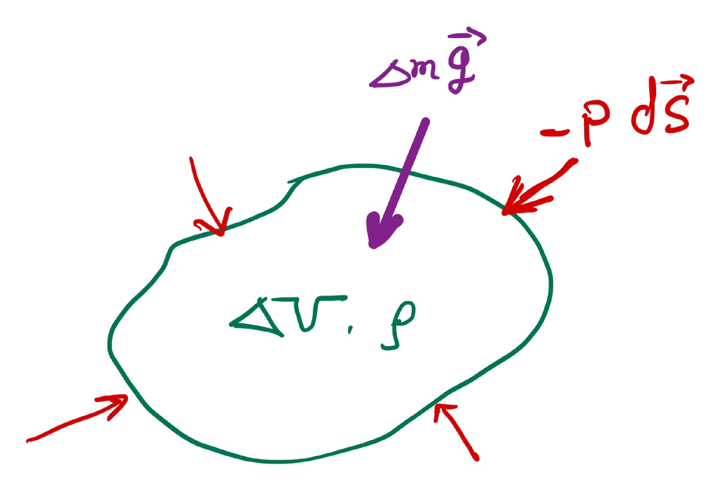


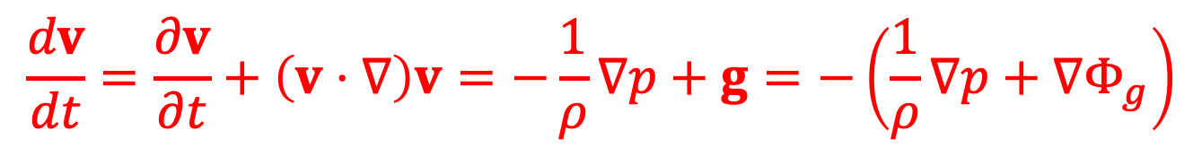

Euler equation (momentum conservation)
In Lagrangian form: $a∆m$= net force acting on an element
Pressure force:
$$−\int{pdS=−\int{∇p dV≈−ΔV ∇p}}$$
Gravitational force:
$$Δm g≈−Δm ∇Φ_{g}$$
Newton’s second law:
$$Δm\frac{dv}{dt}=−ΔV ∇p+Δm g$$
Divide by $Δm$, we get the Euler equation:
$$∂S$$
$$ΔV$$
$$\frac{dv}{dt}=\frac{∂v}{∂t}+\left(v⋅∇\right)v=−\frac{1}{ρ}∇p+g=−\left(\frac{1}{ρ}∇p+∇Φ_{g}\right)$$

Slide 18
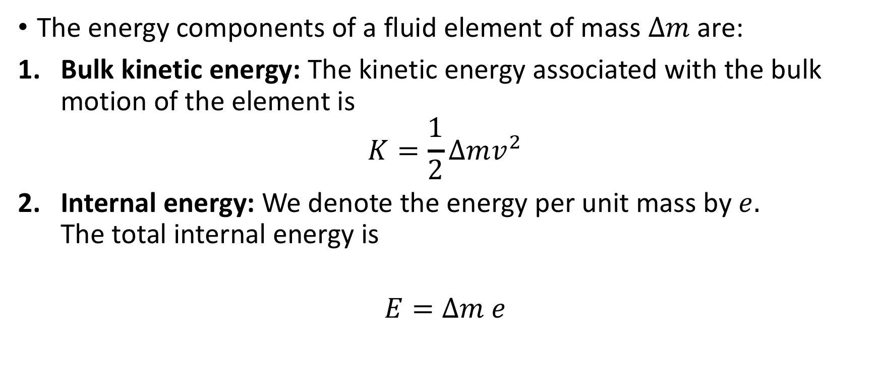
Energy conservation (Lagrangian approach)
The energy components of a fluid element of mass $∆m$ are:
Bulk kinetic energy: The kinetic energy associated with the bulk motion of the element is
$$K=\frac{1}{2}Δmv^{2}$$
Internal energy: We denote the energy per unit mass by $e.$ The total internal energy is
$$E=Δm e$$

Slide 19

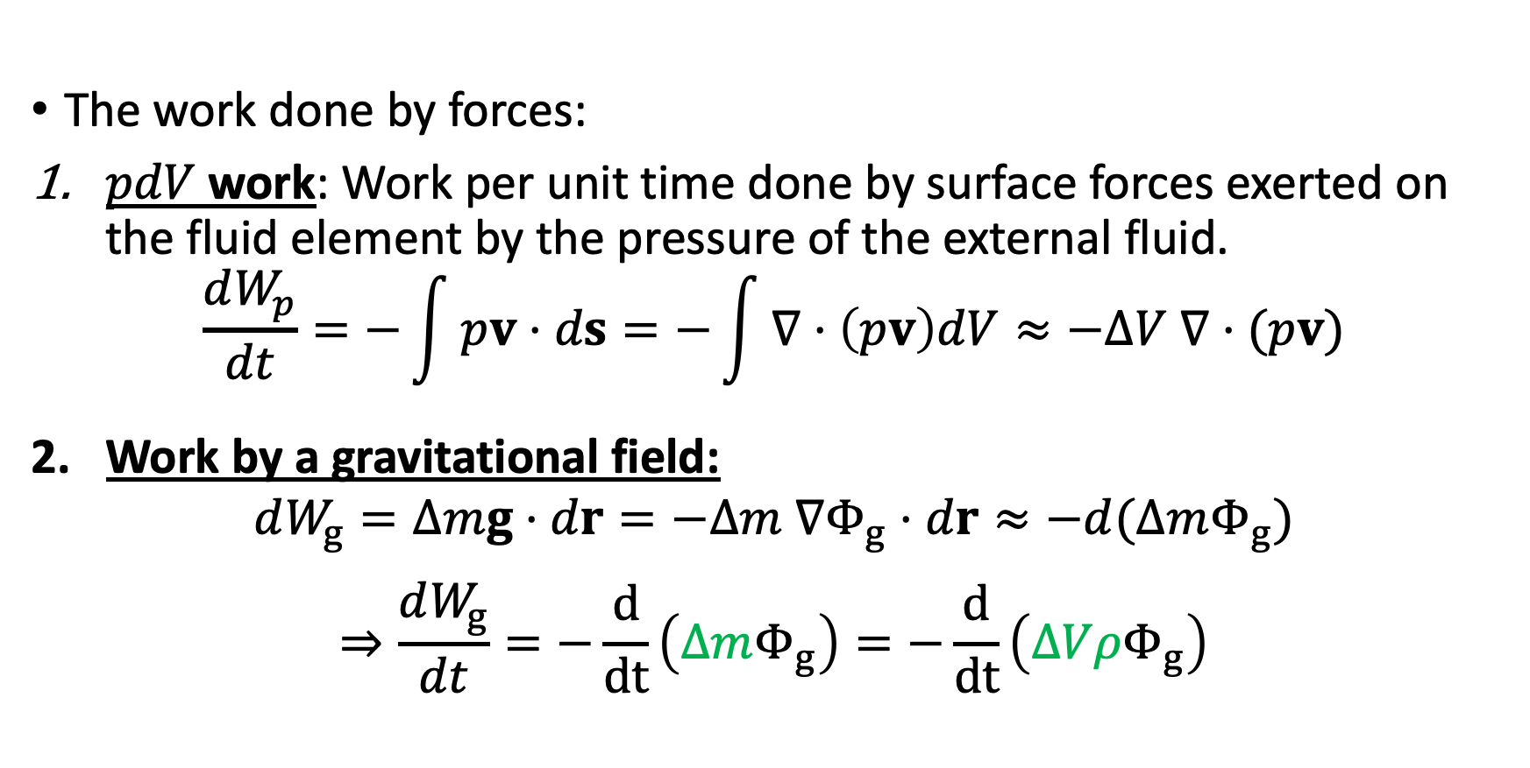

Energy conservation (Lagrangian approach)
The work done by forces:
$pdV$work: Work per unit time done by surface forces exerted on the fluid element by the pressure of the external fluid.
$$\frac{dW_{p}}{dt}=−\int{pv⋅ds=−\int{∇⋅\left(pv\right)dV≈−ΔV ∇⋅(pv)}}$$
Work by a gravitational field:
$$dW_{g}=Δmg⋅dr=−Δm ∇Φ_{g}⋅dr≈−d(ΔmΦ_{g})$$
$$⇒\frac{dW_{g}}{dt}=−\frac{d}{dt}\left(ΔmΦ_{g}\right)=−\frac{d}{dt}\left(ΔVρΦ_{g}\right)$$
1.
$$∂S$$
$$ΔV$$
*We consider only static gravitational fields $g=−∇Φ_{g}$, with $∂Φ_{g}/∂t = 0$

Slide 20

Energy conservation (Lagrangian approach)
Conservation of energy implies
$$\frac{d}{dt}\left(E+K\right)=\frac{dW_{p}}{dt}+\frac{dW_{g}}{dt}=−ΔV ∇⋅(pv)−\frac{d}{dt}\left(Δm Φ_{g}\right)$$
giving
$$\frac{d}{dt}\left[Δm\left(e+\frac{v^{2}}{2}+Φ_{g}\right)\right]=−ΔV ∇⋅(pv)$$

Slide 21
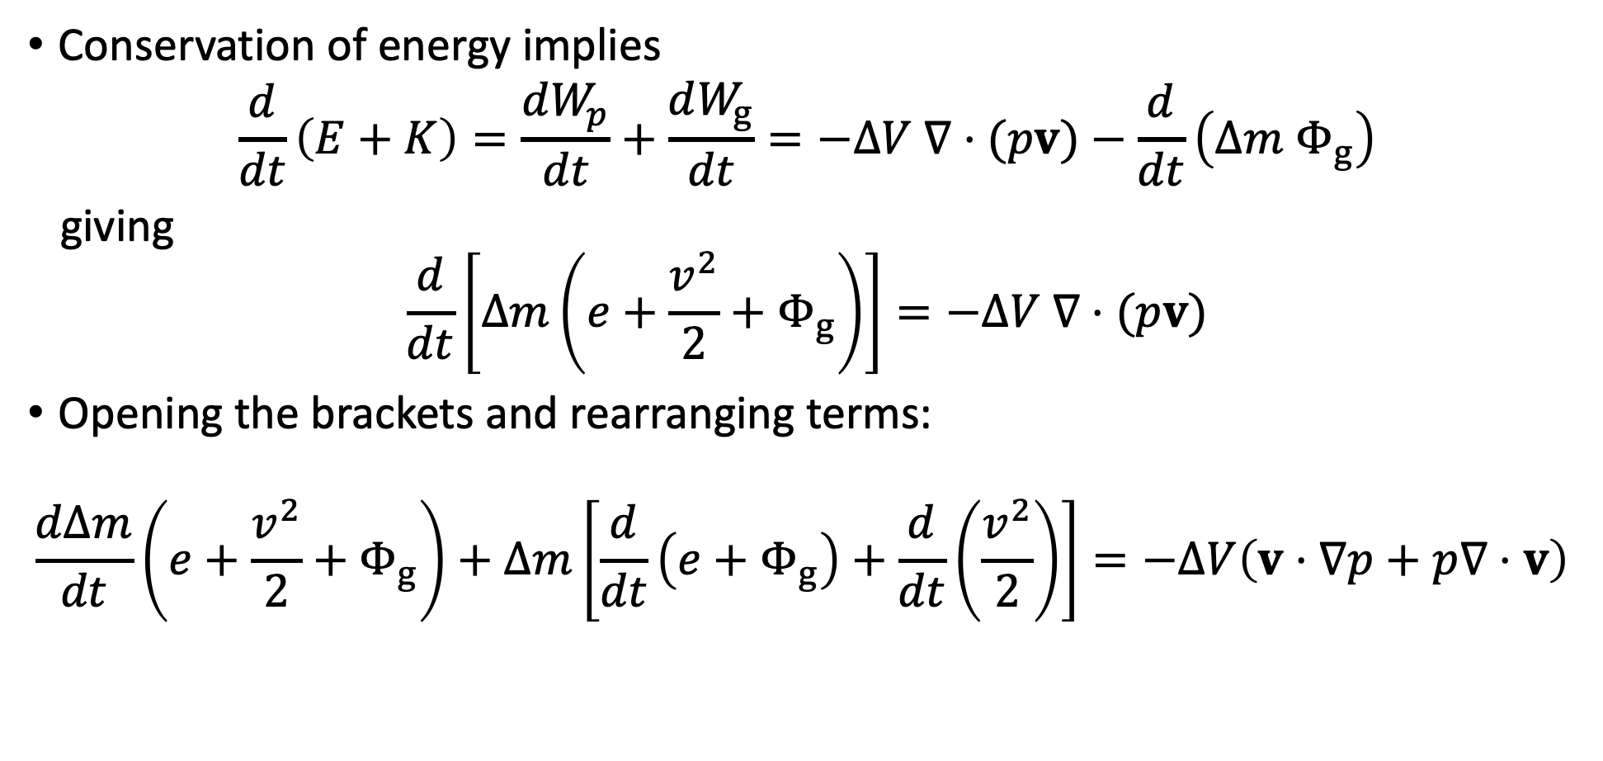
Energy conservation (Lagrangian approach)
Conservation of energy implies
$$\frac{d}{dt}\left(E+K\right)=\frac{dW_{p}}{dt}+\frac{dW_{g}}{dt}=−ΔV ∇⋅(pv)−\frac{d}{dt}\left(Δm Φ_{g}\right)$$
giving
$$\frac{d}{dt}\left[Δm\left(e+\frac{v^{2}}{2}+Φ_{g}\right)\right]=−ΔV ∇⋅(pv)$$
Opening the brackets and rearranging terms:
$$\frac{dΔm}{dt}\left(e+\frac{v^{2}}{2}+Φ_{g}\right)+Δm\left[\frac{d}{dt}\left(e+Φ_{g}\right)+\frac{d}{dt}\left(\frac{v^{2}}{2}\right)\right]=−ΔV\left(v⋅∇p+p∇⋅v\right)$$

Slide 22
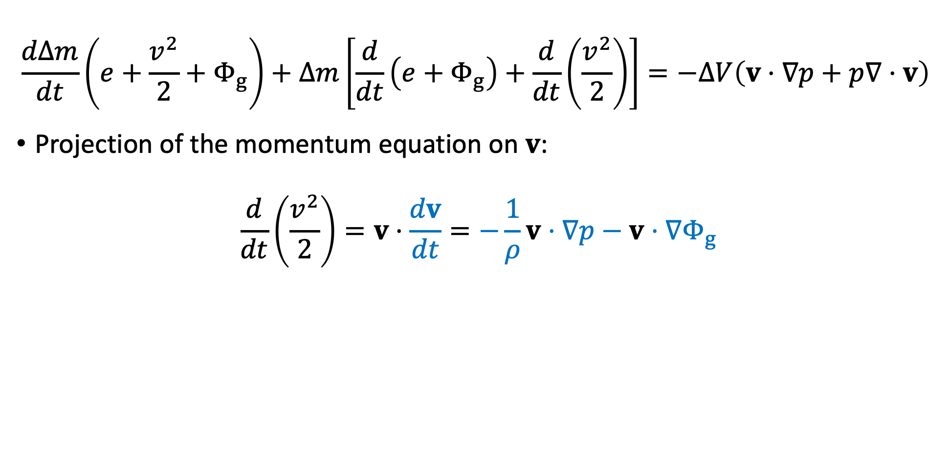
Energy conservation (Lagrangian approach)
$$\frac{dΔm}{dt}\left(e+\frac{v^{2}}{2}+Φ_{g}\right)+Δm\left[\frac{d}{dt}\left(e+Φ_{g}\right)+\frac{d}{dt}\left(\frac{v^{2}}{2}\right)\right]=−ΔV\left(v⋅∇p+p∇⋅v\right)$$
Projection of the momentum equation on $v$:
$$\frac{d}{dt}\left(\frac{v^{2}}{2}\right)=v⋅\frac{dv}{dt}=−\frac{1}{ρ}v⋅∇p−v⋅∇Φ_{g}$$

Slide 23
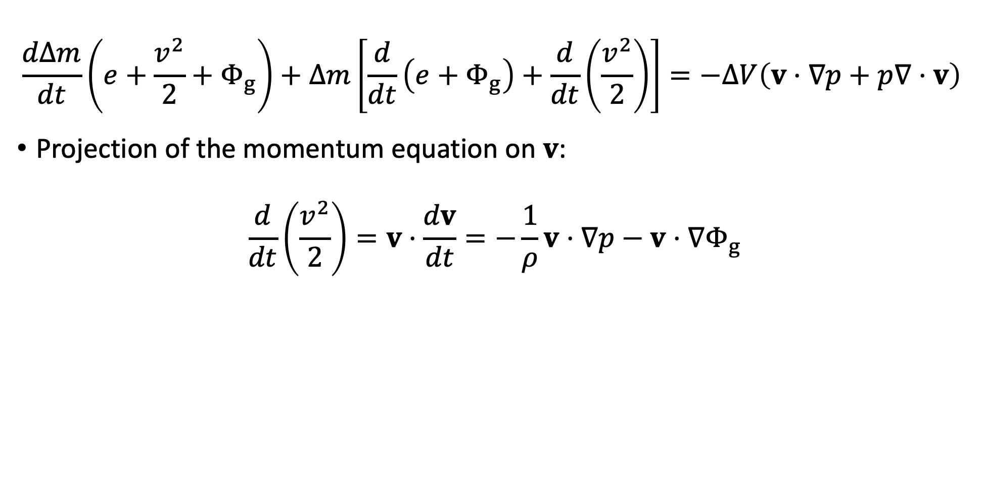
Energy conservation (Lagrangian approach)
$$\frac{dΔm}{dt}\left(e+\frac{v^{2}}{2}+Φ_{g}\right)+Δm\left[\frac{d}{dt}\left(e+Φ_{g}\right)+\frac{d}{dt}\left(\frac{v^{2}}{2}\right)\right]=−ΔV\left(v⋅∇p+p∇⋅v\right)$$
Projection of the momentum equation on $v$:
$$\frac{d}{dt}\left(\frac{v^{2}}{2}\right)=v⋅\frac{dv}{dt}=−\frac{1}{ρ}v⋅∇p−v⋅∇Φ_{g}$$

Slide 24
Energy conservation (Lagrangian approach)
$$\frac{dΔm}{dt}\left(e+\frac{v^{2}}{2}+Φ_{g}\right)+Δm\left[\frac{d}{dt}\left(e+Φ_{g}\right)+\frac{d}{dt}\left(\frac{v^{2}}{2}\right)\right]=−ΔV\left(v⋅∇p+p∇⋅v\right)$$
Projection of the momentum equation on $v$:
$$\frac{d}{dt}\left(\frac{v^{2}}{2}\right)=v⋅\frac{dv}{dt}=−\frac{1}{ρ}v⋅∇p−v⋅∇Φ_{g}$$

Slide 25
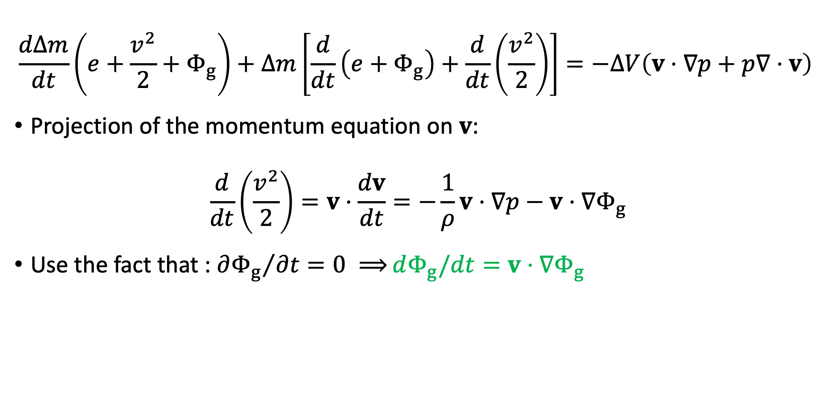
Energy conservation (Lagrangian approach)
$$\frac{dΔm}{dt}\left(e+\frac{v^{2}}{2}+Φ_{g}\right)+Δm\left[\frac{d}{dt}\left(e+Φ_{g}\right)+\frac{d}{dt}\left(\frac{v^{2}}{2}\right)\right]=−ΔV\left(v⋅∇p+p∇⋅v\right)$$
Projection of the momentum equation on $v$:
$$\frac{d}{dt}\left(\frac{v^{2}}{2}\right)=v⋅\frac{dv}{dt}=−\frac{1}{ρ}v⋅∇p−v⋅∇Φ_{g}$$
Use the fact that : ${∂Φ_{g}}/{∂t=0 ⟹}dΦ_{g}/dt=v⋅∇Φ_{g}$

Slide 26
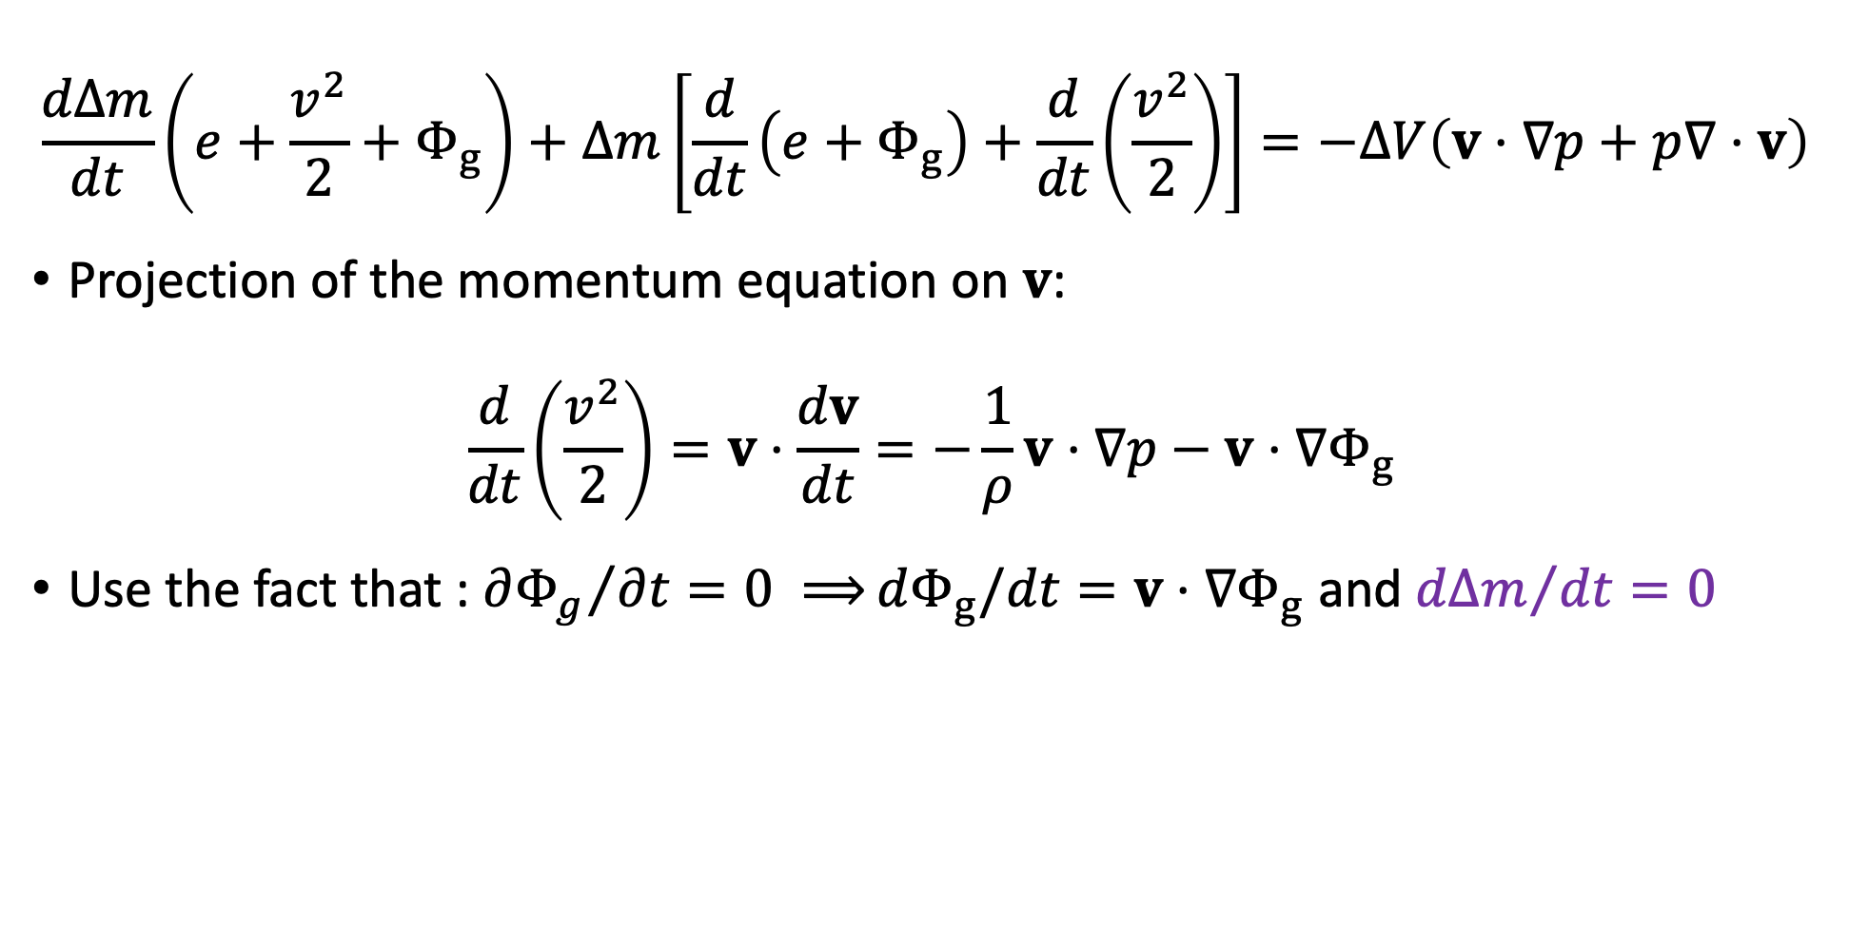
Energy conservation (Lagrangian approach)
$$\frac{dΔm}{dt}\left(e+\frac{v^{2}}{2}+Φ_{g}\right)+Δm\left[\frac{d}{dt}\left(e+Φ_{g}\right)+\frac{d}{dt}\left(\frac{v^{2}}{2}\right)\right]=−ΔV\left(v⋅∇p+p∇⋅v\right)$$
Projection of the momentum equation on $v$:
$$\frac{d}{dt}\left(\frac{v^{2}}{2}\right)=v⋅\frac{dv}{dt}=−\frac{1}{ρ}v⋅∇p−v⋅∇Φ_{g}$$
Use the fact that : ${∂Φ_{g}}/{∂t=0 ⟹}dΦ_{g}/dt=v⋅∇Φ_{g}$ and ${dΔm}/{dt}=0$

Slide 27
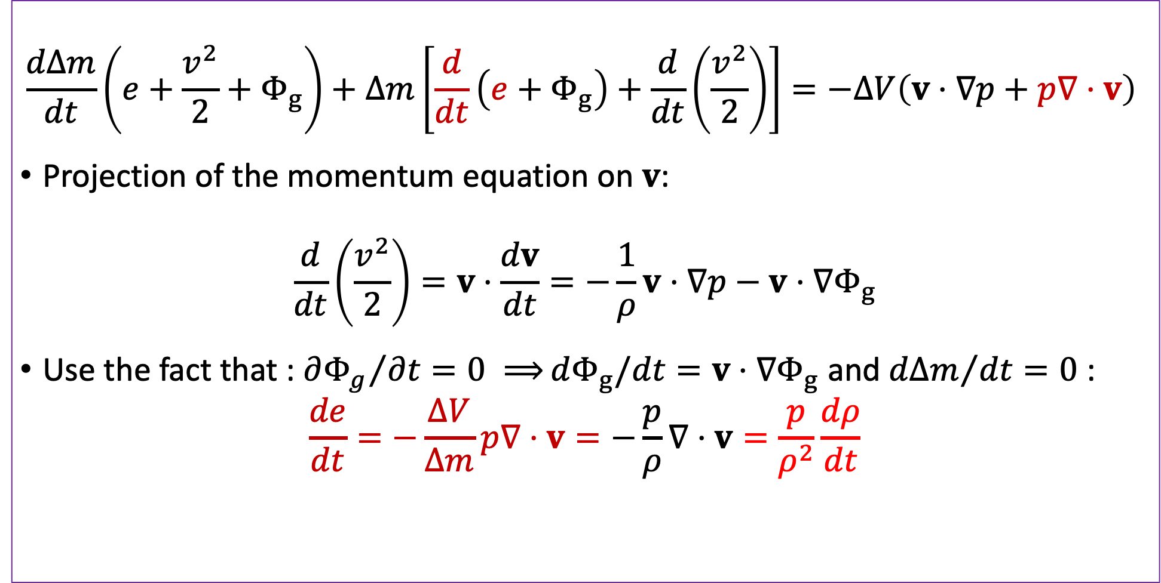
Energy conservation (Lagrangian approach)
$$\frac{dΔm}{dt}\left(e+\frac{v^{2}}{2}+Φ_{g}\right)+Δm\left[\frac{d}{dt}\left(e+Φ_{g}\right)+\frac{d}{dt}\left(\frac{v^{2}}{2}\right)\right]=−ΔV\left(v⋅∇p+p∇⋅v\right)$$
Projection of the momentum equation on $v$:
$$\frac{d}{dt}\left(\frac{v^{2}}{2}\right)=v⋅\frac{dv}{dt}=−\frac{1}{ρ}v⋅∇p−v⋅∇Φ_{g}$$
Use the fact that : ${∂Φ_{g}}/{∂t=0 ⟹}dΦ_{g}/dt=v⋅∇Φ_{g}$ and ${dΔm}/{dt}=0$ :
$$\frac{de}{dt}=−\frac{ΔV}{Δm}p∇⋅v=−\frac{p}{ρ}∇⋅v=\frac{p}{ρ^{2}}\frac{dρ}{dt}$$

Slide 28
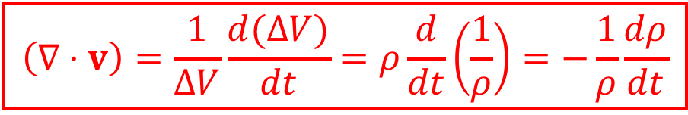

Energy conservation (Lagrangian approach)
$$\frac{dΔm}{dt}\left(e+\frac{v^{2}}{2}+Φ_{g}\right)+Δm\left[\frac{d}{dt}\left(e+Φ_{g}\right)+\frac{d}{dt}\left(\frac{v^{2}}{2}\right)\right]=−ΔV\left(v⋅∇p+p∇⋅v\right)$$
Projection of the momentum equation on $v$:
$$\frac{d}{dt}\left(\frac{v^{2}}{2}\right)=v⋅\frac{dv}{dt}=−\frac{1}{ρ}v⋅∇p−v⋅∇Φ_{g}$$
Use the fact that : ${∂Φ_{g}}/{∂t=0 ⟹}dΦ_{g}/dt=v⋅∇Φ_{g}$ and ${dΔm}/{dt}=0$ :
$$\frac{de}{dt}=−\frac{ΔV}{Δm}p∇⋅v=−\frac{p}{ρ}∇⋅v=\frac{p}{ρ^{2}}\frac{dρ}{dt}$$
Continuity
equation:
$$\left(∇⋅v\right)=\frac{1}{ΔV}\frac{d(ΔV)}{dt}=ρ\frac{d}{dt}\left(\frac{1}{ρ}\right)=−\frac{1}{ρ}\frac{dρ}{dt}$$

Slide 29
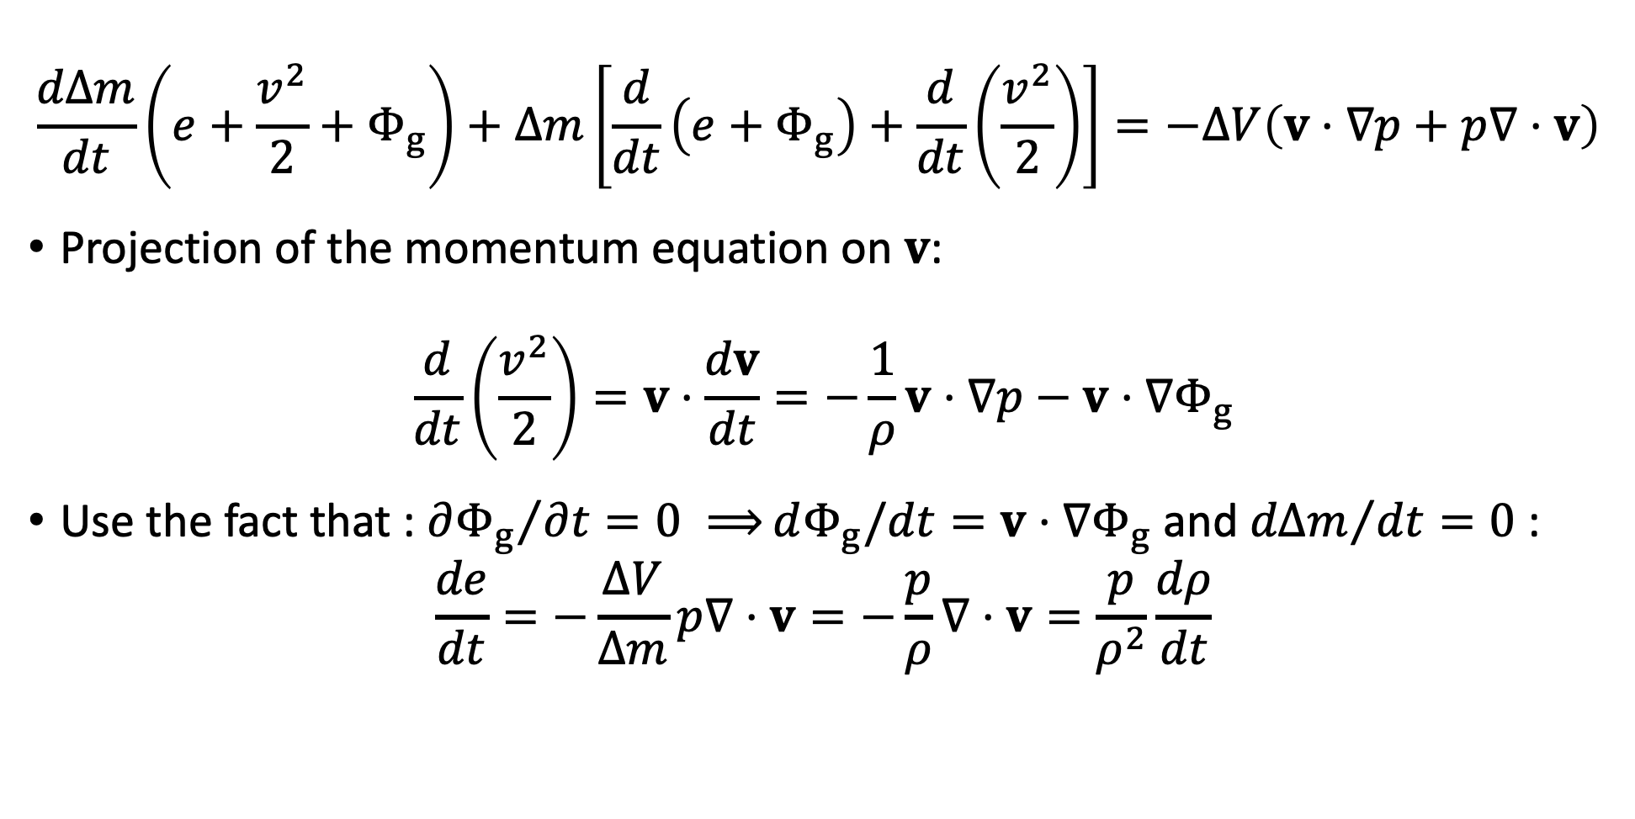
Energy conservation (Lagrangian approach)
$$\frac{dΔm}{dt}\left(e+\frac{v^{2}}{2}+Φ_{g}\right)+Δm\left[\frac{d}{dt}\left(e+Φ_{g}\right)+\frac{d}{dt}\left(\frac{v^{2}}{2}\right)\right]=−ΔV\left(v⋅∇p+p∇⋅v\right)$$
Projection of the momentum equation on $v$:
$$\frac{d}{dt}\left(\frac{v^{2}}{2}\right)=v⋅\frac{dv}{dt}=−\frac{1}{ρ}v⋅∇p−v⋅∇Φ_{g}$$
Use the fact that : ${∂Φ_{g}}/{∂t=0 ⟹}dΦ_{g}/dt=v⋅∇Φ_{g}$ and ${dΔm}/{dt}=0$ :
$$\frac{de}{dt}=−\frac{ΔV}{Δm}p∇⋅v=−\frac{p}{ρ}∇⋅v=\frac{p}{ρ^{2}}\frac{dρ}{dt}$$

Slide 30
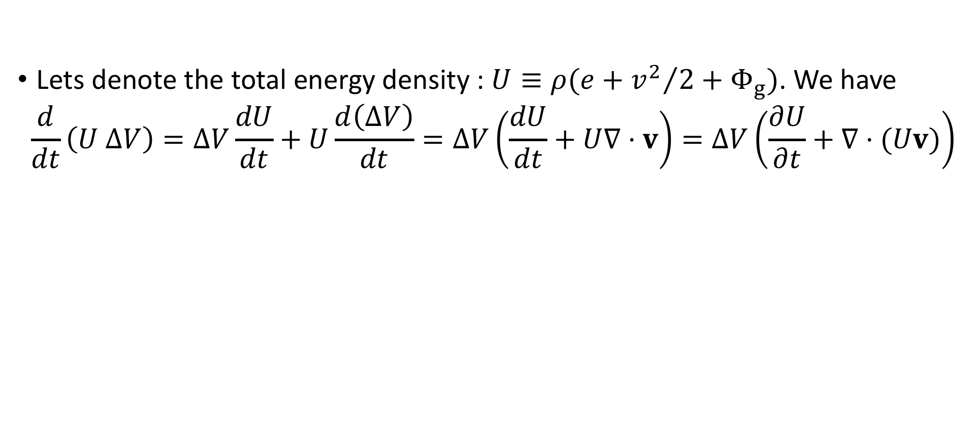
Energy conservation (Eulerian approach)
Lets denote the total energy density : $U≡ρ(e+{v^{2}}/2+Φ_{g})$. We have
$$\frac{d}{dt}\left(U ΔV\right)=ΔV\frac{dU}{dt}+U\frac{d\left(ΔV\right)}{dt}=ΔV\left(\frac{dU}{dt}+U∇⋅v\right)=ΔV\left(\frac{∂U}{∂t}+∇⋅(Uv)\right)$$

Slide 31
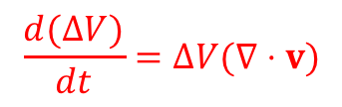
Energy conservation (Eulerian approach)
Lets denote the total energy density : $U≡ρ(e+{v^{2}}/2+Φ_{g})$. We have
$$\frac{d}{dt}\left(U ΔV\right)=ΔV\frac{dU}{dt}+U\frac{d\left(ΔV\right)}{dt}=ΔV\left(\frac{dU}{dt}+U∇⋅v\right)=ΔV\left(\frac{∂U}{∂t}+∇⋅(Uv)\right)$$
$$\frac{d(ΔV)}{dt}=ΔV(∇⋅v)$$

Slide 32
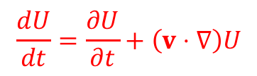
Energy conservation (Eulerian approach)
Lets denote the total energy density : $U≡ρ(e+{v^{2}}/2+Φ_{g})$. We have
$$\frac{d}{dt}\left(U ΔV\right)=ΔV\frac{dU}{dt}+U\frac{d\left(ΔV\right)}{dt}=ΔV\left(\frac{dU}{dt}+U∇⋅v\right)=ΔV\left(\frac{∂U}{∂t}+∇⋅(Uv)\right)$$
$$\frac{dU}{dt}=\frac{∂U}{∂t}+\left(v⋅∇\right)U$$

Slide 33
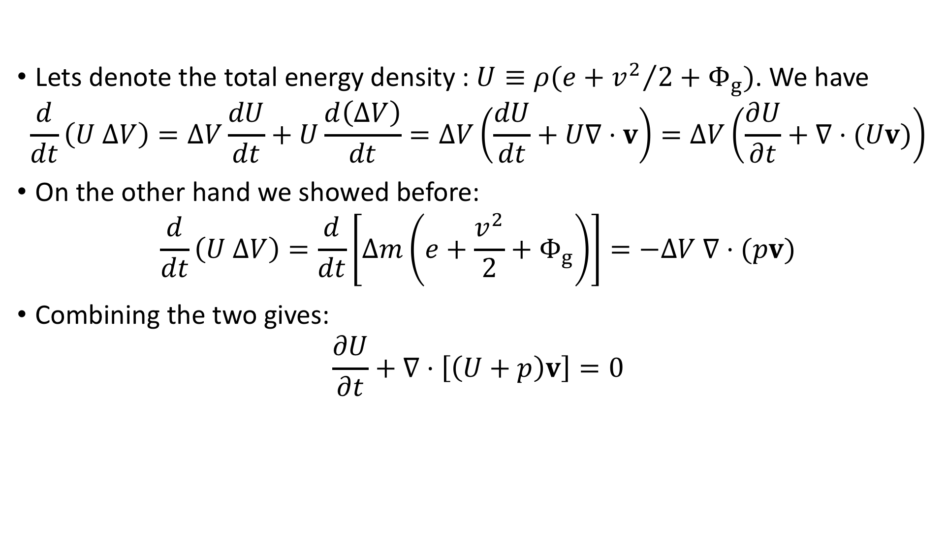
Energy conservation (Eulerian approach)
Lets denote the total energy density : $U≡ρ(e+{v^{2}}/2+Φ_{g})$. We have
$$\frac{d}{dt}\left(U ΔV\right)=ΔV\frac{dU}{dt}+U\frac{d\left(ΔV\right)}{dt}=ΔV\left(\frac{dU}{dt}+U∇⋅v\right)=ΔV\left(\frac{∂U}{∂t}+∇⋅(Uv)\right)$$
On the other hand we showed before:
$$\frac{d}{dt}\left(U ΔV\right)=\frac{d}{dt}\left[Δm\left(e+\frac{v^{2}}{2}+Φ_{g}\right)\right]=−ΔV ∇⋅(pv)$$
Combining the two gives:
$$\frac{∂U}{∂t}+∇⋅\left[\left(U+p\right)v\right]=0$$

Slide 34
Energy conservation (Eulerian approach)
Lets denote the total energy density : $U≡ρ(e+{v^{2}}/2+Φ_{g})$. We have
$$\frac{d}{dt}\left(U ΔV\right)=ΔV\frac{dU}{dt}+U\frac{d\left(ΔV\right)}{dt}=ΔV\left(\frac{dU}{dt}+U∇⋅v\right)=ΔV\left(\frac{∂U}{∂t}+∇⋅(Uv)\right)$$
On the other hand we showed before:
$$\frac{d}{dt}\left(U ΔV\right)=\frac{d}{dt}\left[Δm\left(e+\frac{v^{2}}{2}+Φ_{g}\right)\right]=−ΔV ∇⋅(pv)$$
Combining the two gives:
$$\frac{∂U}{∂t}+∇⋅\left[\left(U+p\right)v\right]=0$$

Slide 35

Energy conservation (Eulerian approach)
Combining the two gives:
$$\frac{∂U}{∂t}+∇⋅\left[\left(U+p\right)v\right]=0$$
Last, we define the enthalpy of a fluid element:
$$H=E+pΔV=Δm\left(e+p/ρ\right)≡Δm h$$
$h$ is the enthalpy per unit mass (specific enthalpy)
Substituting $U=ρ(e+{v^{2}}/2+Φ_{g})$, we get the energy equation:
$$\frac{∂}{∂t}\left[ρ\left(e+\frac{v^{2}}{2}+Φ_{g}\right)\right]+∇⋅\left[ρv\left(h+\frac{v^{2}}{2}+Φ_{g}\right)\right]=0$$

Slide 36


Energy conservation (Eulerian approach)
Combining the two gives:
$$\frac{∂U}{∂t}+∇⋅\left[\left(U+p\right)v\right]=0$$
Last, we define the enthalpy of a fluid element:
$$H=E+pΔV=Δm\left(e+p/ρ\right)≡Δm h$$
$h$ is the enthalpy per unit mass (specific enthalpy)
Substituting $U=ρ(e+{v^{2}}/2+Φ_{g})$, we get the energy equation:
$$\frac{∂}{∂t}\left[ρ\left(e+\frac{v^{2}}{2}+Φ_{g}\right)\right]+∇⋅\left[ρv\left(h+\frac{v^{2}}{2}+Φ_{g}\right)\right]=0$$
$$U$$
$$\left(U+p\right)v$$

Slide 37

Summary of the fluid equations
Continuity equation (mass conservation):
$$\frac{∂ρ}{∂t}+∇⋅\left(ρv\right)=0$$
Euler equation (momentum conservation):
$$\frac{∂v}{∂t}+\left(v⋅∇\right)v=−\frac{1}{ρ}∇p−∇Φ_{g}$$
Energy conservation:
$$\frac{∂}{∂t}\left[ρ\left(e+\frac{v^{2}}{2}+Φ_{g}\right)\right]+∇⋅\left[ρv\left(h+\frac{v^{2}}{2}+Φ_{g}\right)\right]=0$$

Slide 38

Entropy conservation and equation of state
Are the fluid equations consistent with the 2’nd law of thermodynamics?
Lets look at the energy equation in the Lagrange form:
$$\frac{de}{dt}+\frac{p}{ρ}∇⋅v=0$$
Recall the continuity equation:
$$\frac{p}{ρ}\left(∇⋅v\right)=\frac{p}{ρ}\left[\frac{1}{ΔV}\frac{d(ΔV)}{dt}\right]=p\frac{d}{dt}\left(\frac{1}{ρ}\right)=\frac{d}{dt}\left(\frac{p}{ρ}\right)−\frac{1}{ρ}\frac{dp}{dt}$$
We thus obtain:
$$\frac{d}{dt}\left(e+\frac{p}{ρ}\right)−\frac{1}{ρ}\frac{dp}{dt}=\frac{dh}{dt}−\frac{1}{ρ}\frac{dp}{dt}=0$$

Slide 39

Entropy conservation and equation of state
Are the fluid equations consistent with the 2’nd law of thermodynamics?
Lets look at the energy equation in the Lagrange form:
$$\frac{de}{dt}+\frac{p}{ρ}∇⋅v=0$$
Recall the continuity equation:
$$\frac{p}{ρ}\left(∇⋅v\right)=\frac{p}{ρ}\left[\frac{1}{ΔV}\frac{d(ΔV)}{dt}\right]=p\frac{d}{dt}\left(\frac{1}{ρ}\right)=\frac{d}{dt}\left(\frac{p}{ρ}\right)−\frac{1}{ρ}\frac{dp}{dt}$$
We thus obtain:
$$\frac{d}{dt}\left(e+\frac{p}{ρ}\right)−\frac{1}{ρ}\frac{dp}{dt}=\frac{dh}{dt}−\frac{1}{ρ}\frac{dp}{dt}=0$$

Slide 40
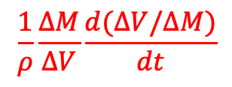

Entropy conservation and equation of state
Are the fluid equations consistent with the 2’nd law of thermodynamics?
Lets look at the energy equation in the Lagrange form:
$$\frac{de}{dt}+\frac{p}{ρ}∇⋅v=0$$
Recall the continuity equation:
$$\frac{p}{ρ}\left(∇⋅v\right)=\frac{p}{ρ}\left[\frac{1}{ΔV}\frac{d(ΔV)}{dt}\right]=p\frac{d}{dt}\left(\frac{1}{ρ}\right)=\frac{d}{dt}\left(\frac{p}{ρ}\right)−\frac{1}{ρ}\frac{dp}{dt}$$
We thus obtain:
$$\frac{d}{dt}\left(e+\frac{p}{ρ}\right)−\frac{1}{ρ}\frac{dp}{dt}=\frac{dh}{dt}−\frac{1}{ρ}\frac{dp}{dt}=0$$
$$\frac{1}{ρ}\frac{ΔM}{ΔV}\frac{d(ΔV/ΔM)}{dt}$$

Slide 41
Entropy conservation and equation of state
Are the fluid equations consistent with the 2’nd law of thermodynamics?
Lets look at the energy equation in the Lagrange form:
$$\frac{de}{dt}+\frac{p}{ρ}∇⋅v=0$$
Recall the continuity equation:
$$\frac{p}{ρ}\left(∇⋅v\right)=\frac{p}{ρ}\left[\frac{1}{ΔV}\frac{d(ΔV)}{dt}\right]=p\frac{d}{dt}\left(\frac{1}{ρ}\right)=\frac{d}{dt}\left(\frac{p}{ρ}\right)−\frac{1}{ρ}\frac{dp}{dt}$$
We thus obtain:
$$\frac{d}{dt}\left(e+\frac{p}{ρ}\right)−\frac{1}{ρ}\frac{dp}{dt}=\frac{dh}{dt}−\frac{1}{ρ}\frac{dp}{dt}=0$$

Slide 42
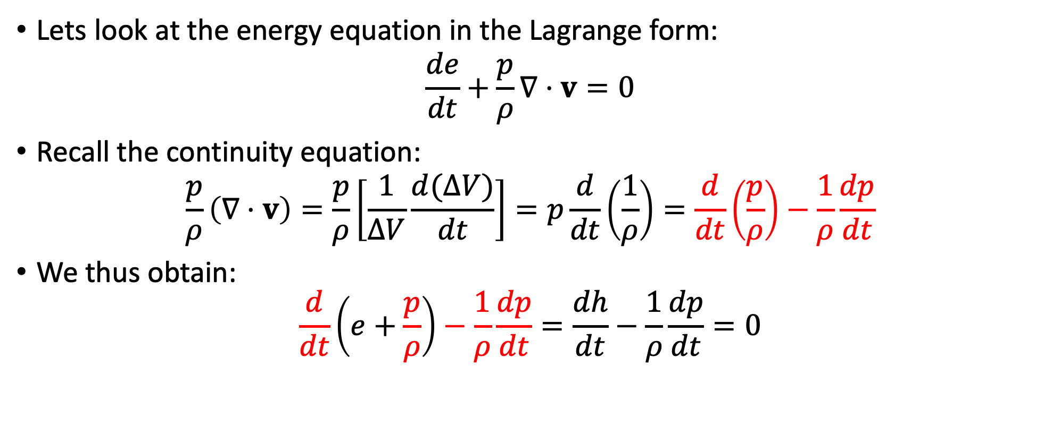
Entropy conservation and equation of state
Are the fluid equations consistent with the 2’nd law of thermodynamics?
Lets look at the energy equation in the Lagrange form:
$$\frac{de}{dt}+\frac{p}{ρ}∇⋅v=0$$
Recall the continuity equation:
$$\frac{p}{ρ}\left(∇⋅v\right)=\frac{p}{ρ}\left[\frac{1}{ΔV}\frac{d(ΔV)}{dt}\right]=p\frac{d}{dt}\left(\frac{1}{ρ}\right)=\frac{d}{dt}\left(\frac{p}{ρ}\right)−\frac{1}{ρ}\frac{dp}{dt}$$
We thus obtain:
$$\frac{d}{dt}\left(e+\frac{p}{ρ}\right)−\frac{1}{ρ}\frac{dp}{dt}=\frac{dh}{dt}−\frac{1}{ρ}\frac{dp}{dt}=0$$

Slide 43
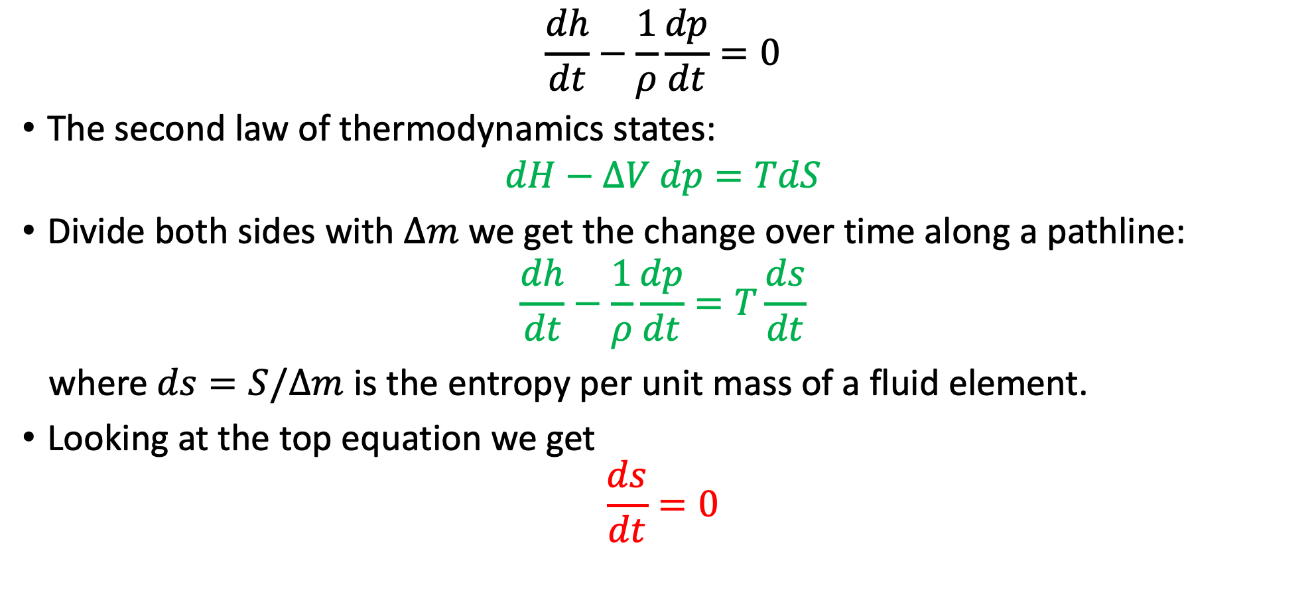
Entropy conservation and equation of state
$$\frac{dh}{dt}−\frac{1}{ρ}\frac{dp}{dt}=0$$
The second law of thermodynamics states:
$$dH−ΔV dp=TdS$$
Divide both sides with $Δm$ we get the change over time along a pathline:
$$\frac{dh}{dt}−\frac{1}{ρ}\frac{dp}{dt}=T\frac{ds}{dt}$$
where $ds=S/Δm$ is the entropy per unit mass of a fluid element.
Looking at the top equation we get
$$\frac{ds}{dt}=0$$

Slide 44
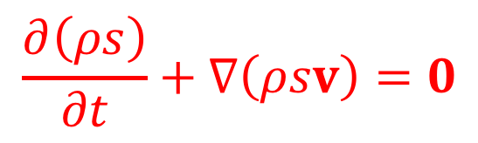

Entropy conservation and equation of state
Looking at the top equation we get :
$$\frac{ds}{dt}=0$$
Since mass is conserved , ${d(Δm)}/{dt}=0$, the total entropy $S=s Δm$ is also conserved.
Consistent with the underlying assumption in the derivation of the energy equation of no heat exchange between the fluid element and its surroundings.
To get the Eulerian form of the entropy equation we write
$$0=\frac{dS}{dt}=\frac{d}{dt}\left(ΔV ρs\right)=ΔV\frac{d\left(ρs\right)}{dt}+\left(ρs\right)\frac{dΔV}{dt}=ΔV\left[\frac{∂\left(ρs\right)}{∂t}+∇(ρsv)\right]$$
or
$$\frac{∂\left(ρs\right)}{∂t}+∇\left(ρsv\right)=0$$
entropy per
unit volume

Slide 45
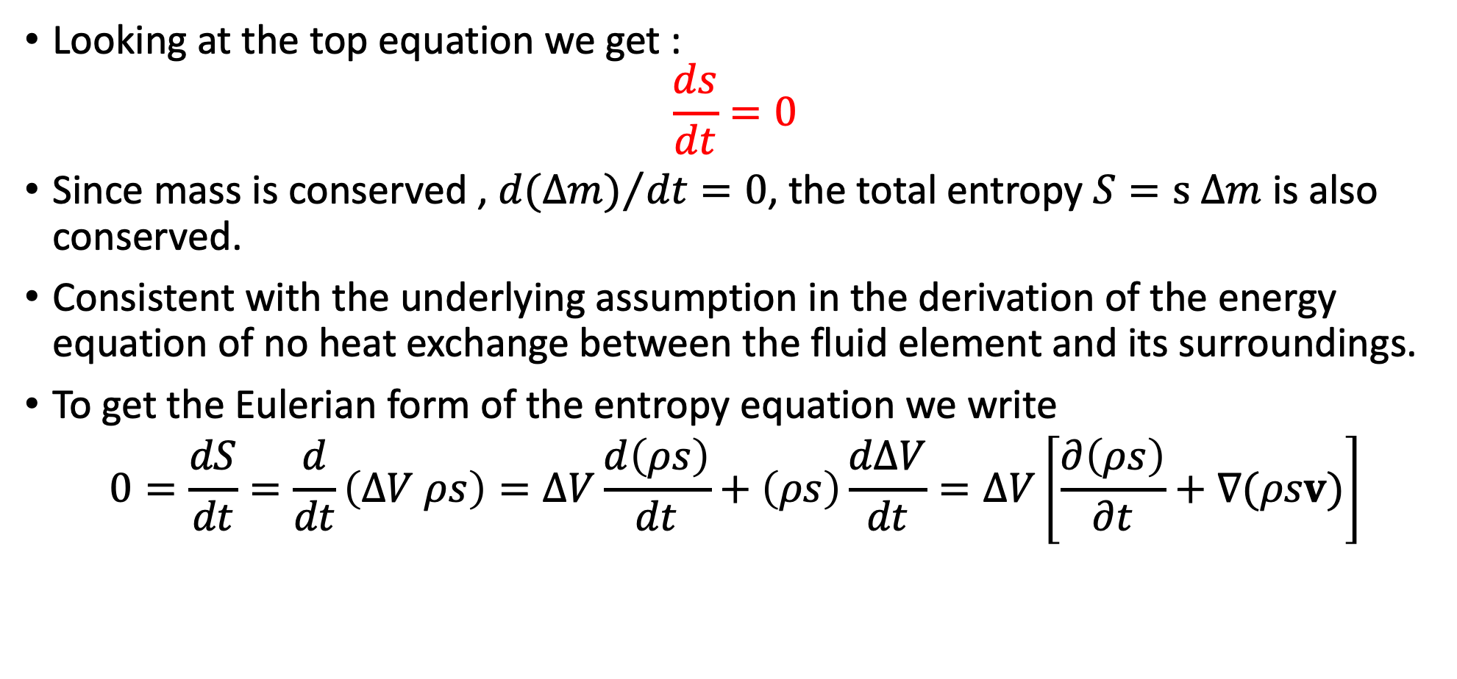
Entropy conservation and equation of state
Looking at the top equation we get :
$$\frac{ds}{dt}=0$$
Since mass is conserved , ${d(Δm)}/{dt}=0$, the total entropy $S=s Δm$ is also conserved.
Consistent with the underlying assumption in the derivation of the energy equation of no heat exchange between the fluid element and its surroundings.
To get the Eulerian form of the entropy equation we write
$$0=\frac{dS}{dt}=\frac{d}{dt}\left(ΔV ρs\right)=ΔV\frac{d\left(ρs\right)}{dt}+\left(ρs\right)\frac{dΔV}{dt}=ΔV\left[\frac{∂\left(ρs\right)}{∂t}+∇(ρsv)\right]$$

Slide 46
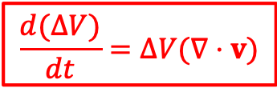
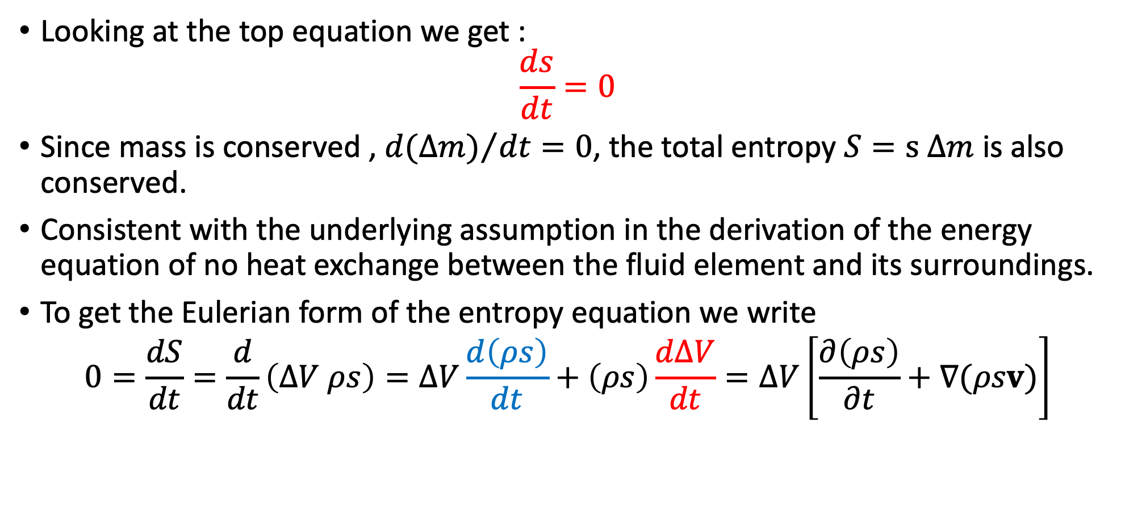
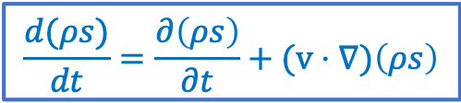
Entropy conservation and equation of state
Looking at the top equation we get :
$$\frac{ds}{dt}=0$$
Since mass is conserved , ${d(Δm)}/{dt}=0$, the total entropy $S=s Δm$ is also conserved.
Consistent with the underlying assumption in the derivation of the energy equation of no heat exchange between the fluid element and its surroundings.
To get the Eulerian form of the entropy equation we write
$$0=\frac{dS}{dt}=\frac{d}{dt}\left(ΔV ρs\right)=ΔV\frac{d\left(ρs\right)}{dt}+\left(ρs\right)\frac{dΔV}{dt}=ΔV\left[\frac{∂\left(ρs\right)}{∂t}+∇(ρsv)\right]$$
$$\frac{d(ρs)}{dt}=\frac{∂\left(ρs\right)}{∂t}+(v⋅∇)\left(ρs\right)$$
$$\frac{d(ΔV)}{dt}=ΔV(∇⋅v)$$

Slide 47
Entropy conservation and equation of state
Looking at the top equation we get :
$$\frac{ds}{dt}=0$$
Since mass is conserved , ${d(Δm)}/{dt}=0$, the total entropy $S=s Δm$ is also conserved.
Consistent with the underlying assumption in the derivation of the energy equation of no heat exchange between the fluid element and its surroundings.
To get the Eulerian form of the entropy equation we write
$$0=\frac{dS}{dt}=\frac{d}{dt}\left(ΔV ρs\right)=ΔV\frac{d\left(ρs\right)}{dt}+\left(ρs\right)\frac{dΔV}{dt}=ΔV\left[\frac{∂\left(ρs\right)}{∂t}+∇(ρsv)\right]$$
or
$$\frac{∂\left(ρs\right)}{∂t}+∇\left(ρsv\right)=0$$
entropy per
unit volume

Slide 48


Entropy conservation and equation of state
Since the entropy equation is derived from the energy and momentum equations , it can be used instead of the energy equation.
Practically it is sufficient to solve the continuity and Euler equations with an additional relation $p(ρ)$.
For an ideal gas with an adiabatic index $Γ$, the quantity $pV^{Γ}$ is conserved.
Taking a fluid element of volume $ΔV$ we get that
$$pΔV^{Γ}=p{\left({Δm}/ρ\right)}^{Γ}=Const$$
and since ${d\left(Δm\right)}/{dt}=0$ we immediately get the adiabatic relation
$$\frac{d}{dt}\left(\frac{p}{ρ^{Γ}}\right)=0$$
The fluid dynamics is now described by the continuity and Euler equations,
and the relation $p/ρ^{Γ} =const$.

Slide 49
Entropy conservation and equation of state
Since the entropy equation is derived from the energy and momentum equations , it can be used instead of the energy equation.
Practically it is sufficient to solve the continuity and Euler equations with an additional relation $p(ρ)$.
For an ideal gas with an adiabatic index $Γ$, the quantity $pV^{Γ}$ is conserved.
Taking a fluid element of volume $ΔV$ we get that
$$pΔV^{Γ}=p{\left({Δm}/ρ\right)}^{Γ}=Const$$
and since ${d\left(Δm\right)}/{dt}=0$ we immediately get the adiabatic relation
$$\frac{d}{dt}\left(\frac{p}{ρ^{Γ}}\right)=0$$
The fluid dynamics is now described by the continuity and Euler equations,
and the relation $p/ρ^{Γ} =const$.

Slide 50

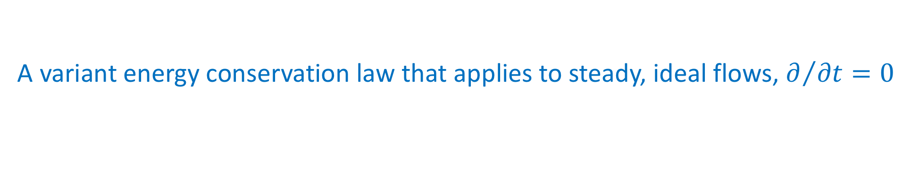



Bernoulli’s theorem
A variant energy conservation law that applies to steady, ideal flows, $∂/{∂t}=0$
The continuity equation in a steady state reduces to:
The energy equation reduces to:
From these we obtain :
Conclusion, the Bernoulli number,
is conserved along streamlines.
$∇⋅\left(ρv\right)=0$
$∇⋅\left[ρv\left(h+\frac{v^{2}}{2}+Φ_{g}\right)\right]=0$
$v⋅∇\left(h+\frac{v^{2}}{2}+Φ_{g}\right)=\frac{d}{dt}\left(h+\frac{v^{2}}{2}+Φ_{g}\right)=0$
$$B≡h+\frac{v^{2}}{2}+Φ_{g}$$

Slide 51

The stress tensor
We can write the momentum equation as:
$$ρ\frac{∂v}{∂t}+ρ\left(v⋅∇\right)v+∇p=−ρ∇Φ_{g}$$

Slide 52

The stress tensor
We can write the momentum equation as:
$$ρ\frac{∂v}{∂t}+ρ\left(v⋅∇\right)v+∇p=−ρ∇Φ_{g}$$
adding the continuity equation :
$$\frac{∂ρ}{∂t}+∇⋅\left(ρv\right)=0$$
we obtain
$$ρ\frac{∂v}{∂t}+v\frac{∂ρ}{∂t}+ρ\left(v⋅∇\right)v+v\left[∇⋅\left(ρv\right)\right]+∇p=−ρ∇Φ_{g}$$

Slide 53

The stress tensor
We can write the momentum equation as:
$$ρ\frac{∂v}{∂t}+ρ\left(v⋅∇\right)v+∇p=−ρ∇Φ_{g}$$
adding the continuity equation :
$$\frac{∂ρ}{∂t}+∇⋅\left(ρv\right)=0$$
we obtain
$$ρ\frac{∂v}{∂t}+v\frac{∂ρ}{∂t}+ρ\left(v⋅∇\right)v+v\left[∇⋅\left(ρv\right)\right]+∇p=−ρ∇Φ_{g}$$
Using Einstein’s notation we get for each vector component $i$:
$$ρ\frac{∂v_{i}}{∂t}+v_{i}\frac{∂ρ}{∂t}+ρv_{k}\frac{∂v_{i}}{∂x_{k}}+v_{i}\frac{∂\left(ρv_{k}\right)}{∂x_{k}}+\frac{∂p}{∂x_{i}}=−ρ\frac{∂Φ_{g}}{∂x_{i}}$$

Slide 54

The stress tensor
$$ρ\frac{∂v_{i}}{∂t}+v_{i}\frac{∂ρ}{∂t}+ρv_{k}\frac{∂v_{i}}{∂x_{k}}+v_{i}\frac{∂\left(ρv_{k}\right)}{∂x_{k}}+\frac{∂p}{∂x_{i}}=−ρ\frac{∂Φ_{g}}{∂x_{i}}$$
This can be written as:
$$\frac{∂}{∂t}{(ρv}_{i})+\frac{∂T_{ik}}{∂x_{k}}=−ρ\frac{∂Φ_{g}}{∂x_{i}}$$
with $T_{ik}$ is the stress energy tensor defined as:
$$T_{ik}=ρv_{i}v_{k}+pδ_{ik}$$

Slide 55
Part II : Sound waves

Slide 56

Sound waves
Longitudinal compression waves that propagate in the fluid
Linear waves: Uniform initial state:
$$p\left(x,t\right)=p_{0}; ρ\left(x,t\right)=ρ_{0}; v\left(x,t\right)=v_{0}$$
We can transform to a frame in which $v_{0}=0$
Add small perturbations:
$$p\left(x,t\right)=p_{0}+δp\left(x,t\right)$$
$$ρ\left(x,t\right)=ρ_{0}+δρ\left(x,t\right)$$
$$v\left(x,t\right)=δv\left(x,t\right)$$

Slide 57

The wave equation
Substitute in the fluid equations:
Continuity:
$$\frac{∂ρ}{∂t}+∇⋅\left(ρv\right)=0$$

Slide 58

The wave equation
Substitute in the fluid equations:
Continuity:
$$\frac{∂ρ}{∂t}+∇⋅\left(ρv\right)=0$$
$$\frac{∂}{∂t}\left[ρ_{0}+δρ\left(x,t\right)\right]+∇⋅\left[\left(ρ_{0}+δρ\left(x,t\right)\right)δv\left(x,t\right)\right]=0$$
$$\frac{∂ρ_{0}}{∂t}+\frac{∂(δρ)}{∂t}+∇⋅\left(ρ_{0}δv\right)+∇⋅(δρδv) =0$$
constant
second order

Slide 59

The wave equation
Substitute in the fluid equations:
Euler:
$$\frac{∂v}{∂t}+\left(v⋅∇\right)v=−\frac{1}{ρ}∇p$$

Slide 60

The wave equation
Substitute in the fluid equations:
Euler:
$$\frac{∂v}{∂t}+\left(v⋅∇\right)v=−\frac{1}{ρ}∇p$$
$$\frac{∂δv}{∂t}+\left(δv⋅∇\right)δv=−\frac{1}{ρ_{0}+δρ}∇{(p}_{0}+δp)$$

Slide 61

The wave equation
Substitute in the fluid equations:
Euler:
$$\frac{∂v}{∂t}+\left(v⋅∇\right)v=−\frac{1}{ρ}∇p$$
$$\frac{∂δv}{∂t}+\left(δv⋅∇\right)δv=−\frac{1}{ρ_{0}+δρ}∇{(p}_{0}+δp)$$
$$\frac{∂δv}{∂t}+\left(δv⋅∇\right)δv=−\frac{1}{ρ_{0}}\left(1−\frac{δρ}{ρ_{0}}\right)∇{(p}_{0}+δp)$$
Taylor

Slide 62

The wave equation
Substitute in the fluid equations:
Euler:
$$\frac{∂v}{∂t}+\left(v⋅∇\right)v=−\frac{1}{ρ}∇p$$
$$\frac{∂δv}{∂t}+\left(δv⋅∇\right)δv=−\frac{1}{ρ_{0}+δρ}∇{(p}_{0}+δp)$$
$$\frac{∂δv}{∂t}+\left(δv⋅∇\right)δv=−\frac{1}{ρ_{0}}\left(1−\frac{δρ}{ρ_{0}}\right)∇{(p}_{0}+δp)$$
second order
second order
constant

Slide 63

The wave equation
The fluid equations for the disturbances:
$$\frac{∂(δρ)}{∂t}+∇⋅\left(ρ_{0}δv\right)=0$$
$$\frac{∂δv}{∂t}+\frac{1}{ρ_{0}}∇\left(δp\right)=0$$

Slide 64

The wave equation
The fluid equations for the disturbances:
$$\frac{∂(δρ)}{∂t}+∇⋅\left(ρ_{0}δv\right)=0$$
$$\frac{∂δv}{∂t}+\frac{1}{ρ_{0}}∇\left(δp\right)=0$$
Adding the adiabatic relation, $p=ρ^{Γ}$:
$$\frac{p_{0}}{ρ_{0}^{Γ}}=\frac{p_{0}+δp}{{\left(ρ_{0}+δρ\right)}^{Γ}}$$
initial
state
disturbed
state

Slide 65

The wave equation
The fluid equations for the disturbances:
$$\frac{∂(δρ)}{∂t}+∇⋅\left(ρ_{0}δv\right)=0$$
$$\frac{∂δv}{∂t}+\frac{1}{ρ_{0}}∇\left(δp\right)=0$$
Adding the adiabatic relation, $p=ρ^{Γ}$:
$$\frac{p_{0}}{ρ_{0}^{Γ}}=\frac{p_{0}+δp}{{\left(ρ_{0}+δρ\right)}^{Γ}}$$
$$\frac{p_{0}}{ρ_{0}^{Γ}}=\frac{1}{ρ_{0}^{Γ}}\left(p_{0}+δp\right)\left(1−Γ\frac{δρ}{ρ_{0}}\right)=\frac{1}{ρ_{0}^{Γ}}\left(p_{0}+δp−\frac{Γp_{0}δρ}{ρ_{0}}−Γ\frac{δpδρ}{ρ_{0}}\right)$$
Taylor:

Slide 66
The wave equation
The fluid equations for the disturbances:
$$\frac{∂(δρ)}{∂t}+∇⋅\left(ρ_{0}δv\right)=0$$
$$\frac{∂δv}{∂t}+\frac{1}{ρ_{0}}∇\left(δp\right)=0$$
Adding the adiabatic relation, $p=ρ^{Γ}$:
$$\frac{p_{0}}{ρ_{0}^{Γ}}=\frac{p_{0}+δp}{{\left(ρ_{0}+δρ\right)}^{Γ}}$$
$$\frac{p_{0}}{ρ_{0}^{Γ}}=\frac{1}{ρ_{0}^{Γ}}\left(p_{0}+δp\right)\left(1−Γ\frac{δρ}{ρ_{0}}\right)=\frac{1}{ρ_{0}^{Γ}}\left(p_{0}+δp−\frac{Γp_{0}δρ}{ρ_{0}}−Γ\frac{δpδρ}{ρ_{0}}\right)$$
Taylor:

Slide 67



The wave equation
The fluid equations for the disturbances:
$$\frac{∂(δρ)}{∂t}+∇⋅\left(ρ_{0}δv\right)=0$$
$$\frac{∂δv}{∂t}+\frac{1}{ρ_{0}}∇\left(δp\right)=0$$
Adding the adiabatic relation, $p=ρ^{Γ}$:
$$\frac{p_{0}}{ρ_{0}^{Γ}}=\frac{p_{0}+δp}{{\left(ρ_{0}+δρ\right)}^{Γ}}$$
$$\frac{p_{0}}{ρ_{0}^{Γ}}=\frac{1}{ρ_{0}^{Γ}}\left(p_{0}+δp\right)\left(1−Γ\frac{δρ}{ρ_{0}}\right)=\frac{1}{ρ_{0}^{Γ}}\left(p_{0}+δp−\frac{Γp_{0}δρ}{ρ_{0}}−Γ\frac{δpδρ}{ρ_{0}}\right)$$
$$δp=\frac{Γp_{0}}{ρ_{0}}δρ$$
$$⟹$$
$$⟹$$
Taylor:

Slide 68

The wave equation
Differentiating again in time
$$\frac{∂(δρ)}{∂t}+∇⋅\left(ρ_{0}δv\right)=0$$
$$\frac{∂δv}{∂t}+\frac{1}{ρ_{0}}∇\left(δp\right)=0$$

Slide 69

The wave equation
Differentiating again in time
$$\frac{∂(δρ)}{∂t^{2}}+\frac{∂}{∂t}∇⋅\left(ρ_{0}δv\right)=0$$
$$\frac{∂δv}{∂t}+\frac{1}{ρ_{0}}∇\left(δp\right)=0$$

Slide 70

The wave equation
Differentiating again in time and in space:
$$\frac{∂(δρ)}{∂t^{2}}+\frac{∂}{∂t}∇⋅\left(ρ_{0}δv\right)=0$$
$$∇⋅\frac{∂δv}{∂t}+\frac{1}{ρ_{0}}∇^{2}\left(δp\right)=0$$

Slide 71



The wave equation
Differentiating again in time and in space:
$$\frac{∂(δρ)}{∂t^{2}}+\frac{∂}{∂t}∇⋅\left(ρ_{0}δv\right)=0$$
$$∇⋅\frac{∂δv}{∂t}+\frac{ρ_{0}}{ρ_{0}}∇^{2}\left(δp\right)=0$$
Multiplying by $ρ_{0}$ and subtracting:
$$−$$
$$ρ_{0}$$

Slide 72


The wave equation
Differentiating again in time and in space:
$$\frac{∂(δρ)}{∂t^{2}}+\frac{∂}{∂t}∇⋅\left(ρ_{0}δv\right)=0$$
$$∇⋅\frac{∂δv}{∂t}+\frac{1}{ρ_{0}}∇^{2}\left(δp\right)=0$$
Multiplying by $ρ_{0}$ and subtracting :
$$\frac{∂(δρ)}{∂t^{2}}−∇^{2}\left(δp\right)=0$$
$$−$$
$$ρ_{0}$$

Slide 73

The wave equation
Differentiating again in time and in space:
$$\frac{∂(δρ)}{∂t^{2}}+\frac{∂}{∂t}∇⋅\left(ρ_{0}δv\right)=0$$
$$∇⋅\frac{∂δv}{∂t}+\frac{1}{ρ_{0}}∇^{2}\left(δp\right)=0$$
Multiplying by $ρ_{0}$ and subtracting :
$$\frac{∂(δρ)}{∂t^{2}}−∇^{2}\left(δp\right)=0$$
$$−$$
$$ρ_{0}$$
$$δp=\frac{Γp_{0}}{ρ_{0}}δρ$$

Slide 74

The wave equation
Differentiating again in time and in space:
$$\frac{∂(δρ)}{∂t^{2}}+\frac{∂}{∂t}∇⋅\left(ρ_{0}δv\right)=0$$
$$∇⋅\frac{∂δv}{∂t}+\frac{1}{ρ_{0}}∇^{2}\left(δp\right)=0$$
Multiplying by $ρ_{0}$ and subtracting :
$$\frac{∂(δρ)}{∂t^{2}}−∇^{2}\left(\frac{Γp_{0}}{ρ_{0}}δρ\right)=0$$
$$−$$
$$ρ_{0}$$

Slide 75

The wave equation
$$\frac{∂(δρ)}{∂t^{2}}−∇^{2}\left(\frac{Γp_{0}}{ρ_{0}}δρ\right)=0$$
Define the sound speed: $c_{s}=\sqrt{\frac{Γp_{0}}{ρ_{0}}}$ and obtain the sound wave equation
$$\frac{∂(δρ)}{∂t^{2}}−{c_{s}^{2}∇}^{2}δρ=0$$

Slide 76


Mach number
Sound waves propagate at speed $c_{s}$ relative to the local fluid frame.
Mach number: The ratio between flow velocity $v$and $c_{s}$
$$ℳ=\frac{v}{c_{s}}$$
There are two distinct regimes of fluid motion:
Subsonic flows: have a small Mach number, $ℳ<1$
Supersonic flows: have a Mach number, $ℳ>1$
Transonic flows: transition from subsonic regime to
supersonic regime or vice versa.

Slide 77
Part III : Characteristics & Riemann invariants

Slide 78
Characteristics and Riemann invariants
We presented characteristics in the context of the Burger’s equation.
Generally characteristics are curves along which PDEs become a family of ODEs.
The technique is used in various numerical methods (e.q. Riemann solvers).
Idea:
Find a set of curves (characteristics), along which initial data is transported.
Evolve the data using the appropriate ODE.
Reconstruct the data to obtain the solution for the PDE.

Slide 79

Example I: the advection equation
Recall the 1D advection equation on $a(x,t)$:
$$\frac{∂a}{∂t}+u\frac{∂a}{∂x}=0$$
where $u$is constant and $a$ satisfies the initial condition
$$a\left(x,0\right)=F(x)$$
A characteristic is a curve along which $a\left(x,t\right)$ is conserved:
$$\frac{da\left(x\left(t\right),t\right)}{dt}=\frac{∂a}{∂t}+\frac{dx}{dt}\frac{∂a}{∂x}=0$$
Looking at the advection equation we see that the characteristic must satisfy
$$\frac{dx}{dt}=u$$

Slide 80
Example I: the advection equation
Recall the 1D advection equation on $a(x,t)$:
$$\frac{∂a}{∂t}+u\frac{∂a}{∂x}=0$$
where $u$is constant and $a$ satisfies the initial condition
$$a\left(x,0\right)=F(x)$$
A characteristic is a curve along which $a\left(x,t\right)$ is conserved:
$$\frac{da\left(x\left(t\right),t\right)}{dt}=\frac{∂a}{∂t}+\frac{dx}{dt}\frac{∂a}{∂x}=0$$
Looking at the advection equation we see that the characteristic must satisfy
$$\frac{dx}{dt}=u$$

Slide 81

Example I: the advection equation
The solution for the characteristic curve is
$$x\left(t\right)=ut+x_{0}$$
where $x_{0}$ is the value of $x(t)$at $t=0$.
Since $a(x,t)$ is constant along this curve (as it was defined as such), it is readily obtained from the initial condition,
$$a\left(x,t\right)=F\left(x_{0}\right)=F(x−ut)$$

Slide 82





Example I: the advection equation
$$a\left(x,t\right)=F\left(x_{0}\right)=F(x−ut)$$
$$a(x,t)$$
Characteristic
$$x(t)=ut+x_{0}$$
$$a(x,0)$$

Slide 83

Example II: Burgers’ equation
Let’s look now at the Burgers’ equation:
$$\frac{∂a}{∂t}+a\frac{∂a}{∂t}=0$$
with the same initial condition as before , $a\left(x,0\right)=F(x)$.
We seek again a solution which is constant along a characteristic $x\left(t\right)$. Formally:
$$\frac{da}{dt}=\frac{∂a}{∂t}+\frac{dx}{dt}\frac{∂a}{∂t}=0$$
where this time
$$\frac{dx}{dt}=a(x\left(t\right),t)$$
can vary with $x$.

Slide 84


Example II: Burgers’ equation
Since $a(x,t)$ is constant along a characteristic (as it was defined as such), we get that the characteristic curve equation satisfies
$$x\left(t\right)=at+x_{0}=F\left(x_{0}\right)t+x_{0}$$
*Unlike before, the slope of the characteristic can vary with $x_{0}$
The solution for $a\left(x,t\right)$ is
$$a\left(x,t\right)=F\left(x_{0}\right)=F(x−a\left(x,t\right)t)$$
$a$ is constant on the curve thus
is set by the initial condition

Slide 85





Example II: Burgers’ equation
$$a\left(x,t\right)=F\left(x_{0}\right)=F(x−a\left(x,t\right)t)$$
$$a(x,t)$$
$$t$$
$$x$$

Slide 86



Riemann invariants for fluid equations
Lets consider the fluid equations in 1D:
$$\frac{∂ρ}{∂t}+v\frac{∂ρ}{∂x}+ρ\frac{∂v}{∂x}=0$$
$$\frac{∂v}{∂t}+v\frac{∂v}{∂x}+\frac{1}{ρ}\frac{∂p}{∂x}=0$$
with an equation of state:
$$p=Aρ^{Γ}$$
The sound speed is a function of the density alone:
$$c_{s}\left(ρ\right)=\sqrt{\frac{Γp\left(ρ\right)}{ρ}}=\sqrt{Γρ^{Γ−1}}, \frac{dc_{s}}{dρ}=\frac{Γ−1}{2}\frac{c_{s}}{ρ}$$
Continuity
$$\left(\frac{∂ρ}{∂t}+∇\left(ρv\right)=0\right)$$
Euler
$$\left(\frac{∂v}{∂t}+\left(v⋅∇\right)v+\frac{1}{ρ}∇p=0\right)$$

Slide 87

Riemann invariants for fluid equations
We can transform from $ρ$ to $c_{S}$ using the relations:
$$\frac{1}{ρ}\left(\frac{∂ρ}{∂t},\frac{∂ρ}{∂x}\right)=\frac{2}{\left(Γ−1\right)c_{s}}\left(\frac{∂c_{s}}{∂t},\frac{∂c_{s}}{∂x}\right); \frac{1}{ρ}\frac{∂p}{∂x}=\frac{2c_{s}}{Γ−1}\frac{∂c_{S}}{∂x}$$
and obtain the fluid equations in $c_{s}$ and $v$:
$$\frac{2}{Γ−1}\left(\frac{∂c_{s}}{∂t}+v\frac{∂c_{s}}{∂x}\right)+c_{s}\frac{∂v}{∂x}=0$$
$$\frac{∂v}{∂t}+v\frac{∂v}{∂x}+\frac{2c_{s}}{Γ−1}\frac{∂c_{S}}{∂x}=0$$
Continuity
Euler

Slide 88

Riemann invariants for fluid equations
Define the Riemann invariants:
$$J_{+}=v+\frac{2}{Γ−1}c_{s}, J_{−}=v−\frac{2}{Γ−1}c_{s}$$
With them the two fluid equations take the form:
$$\frac{∂J_{±}}{∂t}+\left(v±c_{s}\right)\frac{∂J_{±}}{∂x}=0$$
Two advection equations for the variables $J_{+}$, $J_{−}$ where
$$dJ_{+}=0 along C_{+}:\frac{dx}{dt}=v+c_{s}$$
$$dJ_{−}=0 along C_{−}:\frac{dx}{dt}=v−c_{s}$$

Slide 89

Riemann invariants for fluid equations
Define the Riemann invariants:
$$J_{+}=v+\frac{2}{Γ−1}c_{s}, J_{−}=v−\frac{2}{Γ−1}c_{s}$$
With them the two fluid equations take the form:
$$\frac{∂J_{±}}{∂t}+\left(v±c_{s}\right)\frac{∂J_{±}}{∂x}=0$$
Two independent advection equations for the variables $J_{+}$, $J_{−}$ where
$$dJ_{+}=0 along C_{+}:\frac{dx}{dt}=v+c_{s}$$
$$dJ_{−}=0 along C_{−}:\frac{dx}{dt}=v−c_{s}$$

Slide 90

Riemann invariants for fluid equations
Define the Riemann invariants:
$$J_{+}=v+\frac{2}{Γ−1}c_{s}, J_{−}=v−\frac{2}{Γ−1}c_{s}$$
With them the two fluid equations take the form:
$$\frac{∂J_{±}}{∂t}+\left(v±c_{s}\right)\frac{∂J_{±}}{∂x}=0$$
Two independent advection equations for the variables $J_{+}$, $J_{−}$ where
$$dJ_{+}=0 along C_{+}:\frac{dx}{dt}=v+c_{s}$$
$$dJ_{−}=0 along C_{−}:\frac{dx}{dt}=v−c_{s}$$
Eigenvalues

Slide 91

Example: a simple wave
Simple waves are solutions for which one of the Riemann invariants is constant.
Suppose that $J_{−}=c_{0}$.
Then using the equation for $J_{−}$ we see that $c_{s}$ depends only on $v$:
$$c_{s}=\frac{Γ−1}{2}(v−c_{0})$$
and the eigenvalue
$$A_{+}=v+c_{s}=\frac{Γ+1}{2}v−\frac{Γ−1}{2}c_{0}$$

Slide 92

Example: a simple wave
Simple waves are solutions for which one of the Riemann invariants is constant.
Suppose that $J_{−}=c_{0}$.
Then using the equation for $J_{−}$ we see that $c_{s}$ depends only on $v$:
$$c_{s}=\frac{Γ−1}{2}(v−c_{0})$$
and the eigenvalue
$$A_{+}=v+c_{s}=\frac{Γ+1}{2}v−\frac{Γ−1}{2}c_{0}$$
The second invariant then becomes
$$J_{+}=v+\frac{2}{Γ−1}c_{s}=2v−c_{0}$$

Slide 93

Example: a simple wave
Simple waves are solutions for which one of the Riemann invariants is constant.
Suppose that $J_{−}=c_{0}$.
Then using the equation for $J_{−}$ we see that $c_{s}$ depends only on $v$:
$$c_{s}=\frac{Γ−1}{2}(v−c_{0})$$
and the eigenvalue
$$A_{+}=v+c_{s}=\frac{Γ+1}{2}v−\frac{Γ−1}{2}c_{0}$$
The second invariant then becomes
$$J_{+}=v+\frac{2}{Γ−1}c_{s}=2v−c_{0}$$
Since $c_{0}$ is a constant $dJ_{+}∝dv$.

Slide 94

Example: a simple wave
The second invariant becomes
$$J_{+}=v+\frac{2}{Γ−1}c_{s}=2v−c_{0}$$
Since $c_{0}$ is a constant $dJ_{+}∝dv$.
We therefore get an advection equation for $v$:
$$\frac{∂J_{+}}{∂t}+\left(v+c_{s}\right)\frac{∂J_{+}}{∂x}=0 ⟹ \frac{∂v}{∂t}+A_{+}(v)\frac{∂v}{∂x}=0$$

Slide 95

Example: a simple wave
The second invariant becomes
$$J_{+}=v+\frac{2}{Γ−1}c_{s}=2v−c_{0}$$
Since $c_{0}$ is a constant $dJ_{+}∝dv$.
We therefore get an advection equation for $v$:
$$\frac{∂J_{+}}{∂t}+\left(v+c_{s}\right)\frac{∂J_{+}}{∂x}=0 ⟹ \frac{∂v}{∂t}+A_{+}(v)\frac{∂v}{∂x}=0$$
for which we can obtain implicit solutions using the characteristic method:
$$v\left(x,t\right)=F(x_{0})=F\left[x−A_{+}\left(v\right)t\right]$$
where $F\left(x_{0}\right)=v(x_{0},0)$ is the initial shape of the wave.

Slide 96


Example: a simple wave
The initial data is transported along the curves
$x\left(t\right)=x_{0}+A_{+}\left[F\left(x_{0}\right)\right]t$
The velocity derivative evolves as:
$$\frac{∂v}{∂x}=\frac{{dF(x_{0})}/{dx_{0}}}{1+({dA_{+}}/{dx_{0})t}}$$
where ${dA}/{dx_{0}=\frac{1}{2}(Γ+1){dF}/{dx_{0}} }$
If ${dF}/{dx_{0}}<0$ somewhere along the wave, the wave will break at a time:
$$T=\frac{1}{{\left({−dA}/{dx_{0}}\right)}_{max}}=\frac{2/{\left(Γ+1\right)}}{{\left({−dF}/{dx_{0}}\right)}_{max}}$$
A shock forms

Slide 97
Shock waves
Shockwaves are discontinuities that form in a flow when a part of the flow becomes supersonic.
Across the discontinuity the flow parameters change abruptly (jump).

Slide 98

Shock waves
Shockwaves are discontinuities that form in a flow when a part of the flow becomes supersonic.
Across the discontinuity the flow parameters change abruptly (jump).
Let’s consider a shock wave in a 1D flow.
In the frame of the shock the flow has a steady velocity $v=v\hat{x}$.
In this frame the flow equations are time independent, and are reduced to
$$\frac{d}{dx}\left(ρv\right)=0$$
$$\frac{d}{dx}\left(ρv^{2}+p\right)=0$$
$$\frac{d}{dx}\left[ρv\left(h+\frac{v^{2}}{2}\right)\right]=0$$

Slide 99


Shock waves
Integrating across the shock we obtain the Rankine–Hugoniot jump conditions:
$$ρ_{1}v_{1}=ρ_{2}v_{2}$$
$$ρ_{1}v_{1}^{2}+p_{1}=ρ_{2}v_{2}^{2}+p_{2}$$
$$h_{1}+\frac{1}{2}v_{1}^{2}=h_{2}+\frac{1}{2}v_{2}^{2}$$
These equations must be augmented by a relation between upstream and downstream equations of state.

Slide 100

Shock waves
Assume a barotropic fluid on both sides ($γ$-law EOS) with the same adiabatic index. Then
$$h_{1}=\frac{Γ}{Γ−1} \frac{p_{1}}{ρ_{1}}, h_{2}=\frac{Γ}{Γ−1} \frac{p_{2}}{ρ_{2}}$$
The solutions to the shock equations read:
$$\frac{ρ_{1}}{ρ_{2}}=\frac{v_{2}}{v_{1}}=\frac{Γ−1}{Γ+1}+\frac{2}{\left(Γ+1\right)ℳ_{1}^{2}}$$
$$\frac{p_{2}}{p_{1}}=\frac{2Γ}{\left(Γ+1\right)}ℳ_{1}^{2}−\frac{Γ−1}{Γ+1}$$

Slide 101



Shock waves
The solutions to the shock equations read:
$$\frac{ρ_{1}}{ρ_{2}}=\frac{v_{2}}{v_{1}}=\frac{Γ−1}{Γ+1}+\frac{2}{\left(Γ+1\right)ℳ_{1}^{2}}$$
$$\frac{p_{2}}{p_{1}}=\frac{2Γ}{\left(Γ+1\right)}ℳ_{1}^{2}−\frac{Γ−1}{Γ+1}$$
For highly supersonic flow, vis. $ℳ_{1}≫1$ we have
$$\frac{ρ_{1}}{ρ_{2}}=\frac{v_{2}}{v_{1}}⟶\frac{Γ−1}{Γ+1}$$
$$\frac{p_{2}}{p_{1}}⟶\frac{2Γ}{\left(Γ+1\right)}ℳ_{1}^{2}$$
$$\frac{T_{2}}{T_{1}}=\frac{{p_{2}}/{ρ_{2}}}{{p_{1}}/{ρ_{1}}}⟶\frac{2Γ}{\left(Γ−1\right)}ℳ_{1}^{2}$$
$$Γ=5/3$$
$${ρ_{2}}/{ρ_{1}}=4$$

Slide 102

Riemann problem
Shocks and rarefaction waves are states that occur in a single fluid and maintain a continuous flow through them of all hydrodynamic parameters.
Rarefaction
Shock
$$u(x,t)$$
$$t$$
$$x$$

Slide 103





Riemann problem
Shocks and rarefaction waves are states that occur in a single fluid and maintain a continuous flow through them of all hydrodynamic parameters.
In finite volume scheme each cell holds different fluid parameters, which are discontinuous across the cell boundary.
The situation resembles a collision between two different fluids, a problem known as the Riemann problem.
$$ρ_{i}^{n},u_{i}^{n},p_{i}^{n}$$
$$ρ_{i+1}^{n},u_{i+1}^{n},p_{i+1}^{n}$$
$$i$$
$$i+1$$

Slide 104










Riemann problem
When two fluids come into contact with each other 4 zones separated by 3 transition regions are form, which satisfy the continuity equations:
$$ρ_{L}\left(v_{L}−v_{s2}\right)=ρ_{2}\left(v_{2}−v_{s2}\right)$$
$$ρ_{L}{\left(v_{L}−v_{s2}\right)}^{2}+p_{L}=ρ_{2}{\left(v_{2}−v_{s2}\right)}^{2}+p_{2}$$
$$h_{L}+\frac{1}{2}{\left(v_{L}−v_{s2}\right)}^{2}=h_{2}+\frac{1}{2}{\left(v_{2}−v_{s2}\right)}^{2}$$
$$v_{2}=v_{1}$$
$$v_{c}=v_{1}$$
$$p_{2}=p_{1}$$
$$ρ_{1}\left(v_{1}−v_{s1}\right)=ρ_{R}\left(v_{R}−v_{s1}\right)$$
$$ρ_{1}{\left(v_{1}−v_{s1}\right)}^{2}+p_{1}=ρ_{R}{\left(v_{R}−v_{s1}\right)}^{2}+p_{R}$$
$h_{1}+\frac{1}{2}{\left(v_{1}−v_{s1}\right)}^{2}=h_{R}+\frac{1}{2}{\left(v_{R}−v_{s1}\right)}^{2}$
$$L$$
$$2$$
$$1$$
$$R$$
$$v_{s2}$$
$$v_{c}$$
$$v_{s1}$$

Slide 105



Riemann problem
When two fluids come into contact with each other 4 zones separated by 3 transition regions are form, which satisfy the continuity equations:
$$ρ_{L}\left(v_{L}−v_{s2}\right)=ρ_{2}\left(v_{2}−v_{s2}\right)$$
$$ρ_{L}{\left(v_{L}−v_{s2}\right)}^{2}+p_{L}=ρ_{2}{\left(v_{2}−v_{s2}\right)}^{2}+p_{2}$$
$$h_{L}+\frac{1}{2}{\left(v_{L}−v_{s2}\right)}^{2}=h_{2}+\frac{1}{2}{\left(v_{2}−v_{s2}\right)}^{2}$$
$$v_{2}=v_{1}$$
$$v_{c}=v_{1}$$
$$p_{2}=p_{1}$$
$$ρ_{1}\left(v_{1}−v_{s1}\right)=ρ_{R}\left(v_{R}−v_{s1}\right)$$
$$ρ_{1}{\left(v_{1}−v_{s1}\right)}^{2}+p_{1}=ρ_{R}{\left(v_{R}−v_{s1}\right)}^{2}+p_{R}$$
$h_{1}+\frac{1}{2}{\left(v_{1}−v_{s1}\right)}^{2}=h_{R}+\frac{1}{2}{\left(v_{R}−v_{s1}\right)}^{2}$

